Slide 1

Fake NEWS DETECTION
Submitted by:
Ankita Ramdas Mhetre

Slide 2
Conceptual Background and domain knowledge
Fake news refers to misinformation or disinformation in the country which is spread through word of mouth and traditional media and more recently through digital forms of communication such as edited videos, memes, unverified advertisements and social media propagated rumours.
Fake news spread through social media in the country has become a serious problem, with the potential of it resulting in mob violence.
Some news has a significant impact not only on the people or government but also on the economy.
In the news industry, in particular, but also in society at large, fake news detection has become a central discussion topic, as the need to permanently assess the veracity of digital content has been raised by the constant spread of false news / information.

Slide 3
Conceptual Background and domain knowledge
Information veracity is a long-term issue affecting society both for printed and digital media.
It is important to identify the fake news from the real true news. The problem has been taken over and resolved with the help of Natural Language Processing tools which help us identify fake or true news based on historical data. The news is now in safe hands!
This project work makes an analysis of the research related to fake news detection and explores the traditional machine learning models to choose the best, in order to create a model of a product with supervised machine learning algorithm, that can classify fake news as true or false, by using tools like python scikit-learn, NLP for textual analysis.

Slide 4
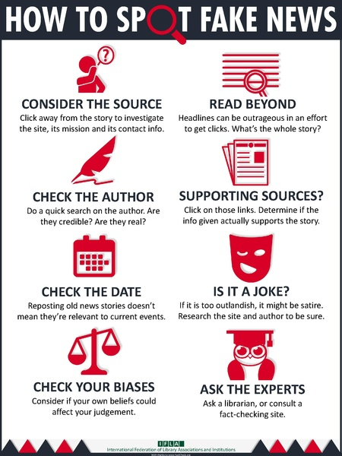
Conceptual Background domain Knowledge
How can we differentiate between fake news and real news :

Slide 5

Problem Definition
The authenticity of Information has become a longstanding issue affecting businesses and society, both for printed and digital media. On social networks, the reach and effects of information spread occur at such a fast pace and so amplified that distorted, inaccurate, or false information acquires a tremendous potential to cause real-world impacts, within minutes, for millions of users.

Slide 6
Problem Definition
Recently, several public concerns about this problem and some approaches to mitigate the problem were expressed.
In this project, we are given a dataset to build a model to predict whether news is fake or not fake.
Our sole objective is to classify the news from the dataset as fake or true news.
We have performed extensive EDA of news and selecting and building a powerful model for classification.

Slide 7
Dataset Description
There are 20800 rows/records in the dataset provided.
There are 6 columns in the dataset provided. The description of each of the column is given below:
id: Unique id of each news article
headline: It is the title of the news.
news: It contains the full text of the news article
Unnamed:0: It is a serial number
written by: It represents the author of the news article
label: It tells whether the news is fake (1) or not fake (0).
There were total of 2554 Null values in 3 different columns.
“Headline” , “news”, “written_by” were object type
“id” , “label” and “unnamed 0” columns were integer data type.

Slide 8
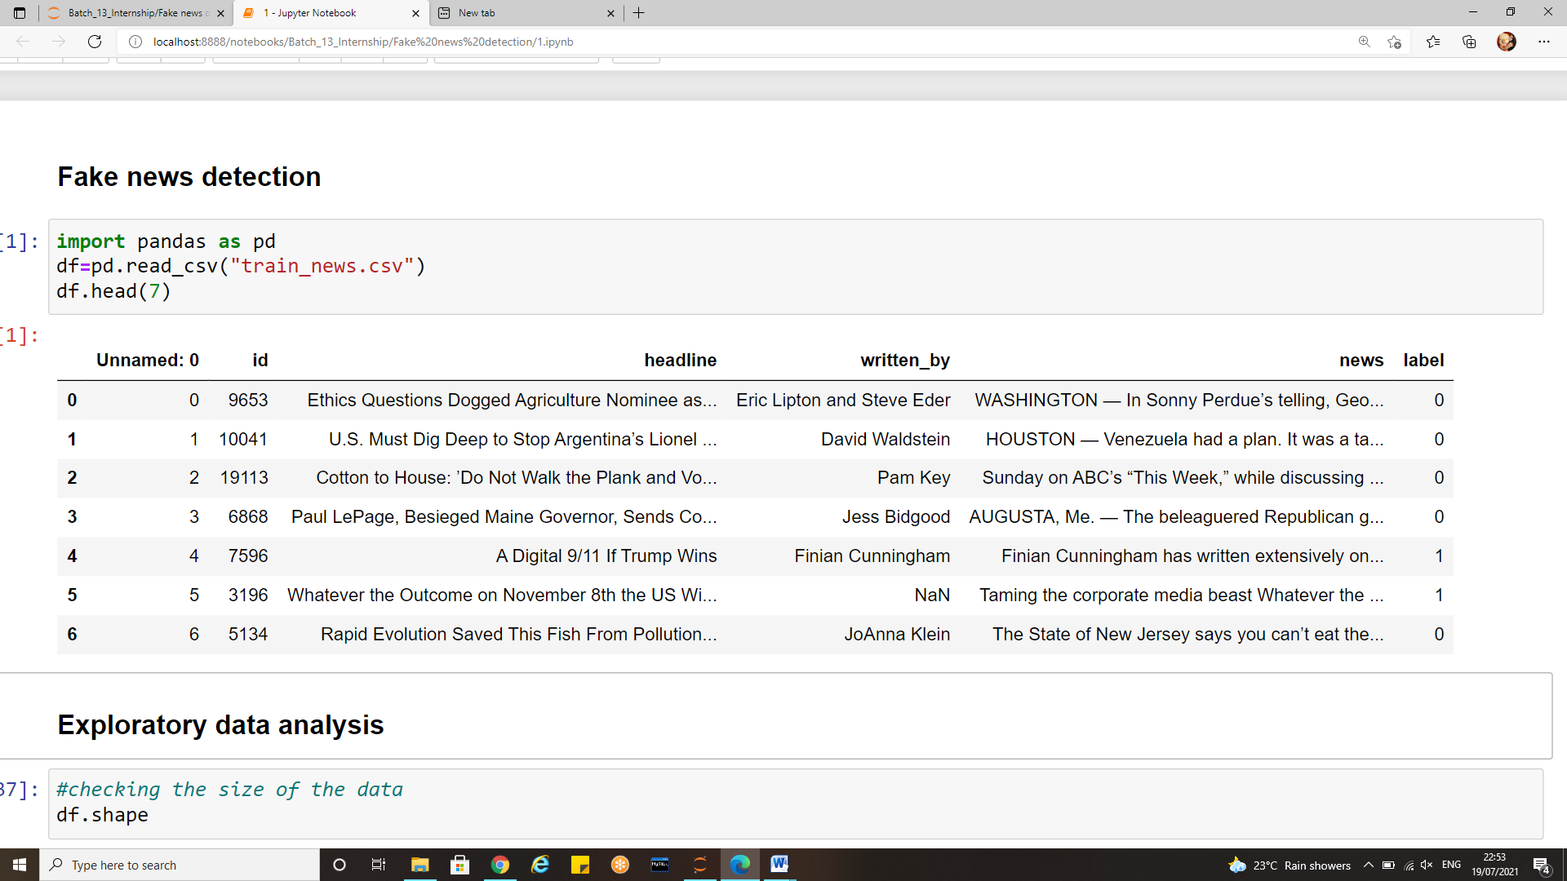
Dataset Description

Slide 9

Data pre-processing
Natural Language Processing (NLP) is a branch of Data Science which deals with Text data. To prepare the text data for the model building we perform text preprocessing. It transforms text from its raw format into something that is more process able for computer algorithms.
The goal of our pre-processing is to achieve normalization and noise removal from the dataset before we experiment with different embedding and models.

Slide 10
Data pre-processing steps
There are different ways to preprocess text. Here are some of the approaches that we should know about and we will try to highlight the importance of each.
Remove HTML tags
Remove punctuations
Remove special characters
Lowercase all texts
Remove stop words
Lemmatization
Word vectorization

Slide 11
Removing special characters and punctuations
Noise removal refers to removing characters digits and pieces of text that can interfere with the text analysis. There are various ways to remove noise, including punctuation removal, special character removal, and numbers removal, html formatting removal, domain specific keyword removal, source code removal, and more.
Noise removal is highly domain dependent. For example, in tweets, noise could be all special characters except hash tags as they signify concepts that can characterize a tweet.
The generic problem faced by the programmers is removing a character from the entire string. But sometimes the requirement is way above and demands the removal of more than 1 character, but a list of such malicious characters.

Slide 12
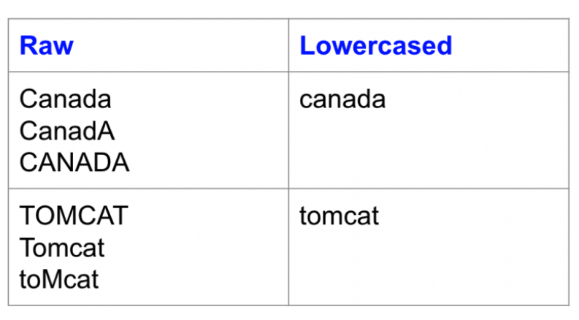
Converting text to lower case
We first set out to normalize the dataset by converting all the characters to lowercase. This helps us even the playing field for words since lexically a capitalized word should not have a different weight than a non-capitalized word. Lowercasing is a great way to deal with sparsity issues

Slide 13
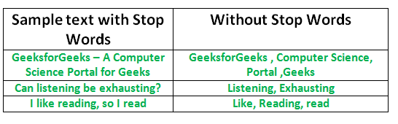
Removing stop words
Common words (like a, an, and, are, as etc.) appear with a high frequency in comments, but add very little value to the classification problem as they do not have any specific polarity. Hence, we decided to remove stop words to further DE noise the input.
We used NLTK’s stop words package to provide us with the list of stop words.

Slide 14
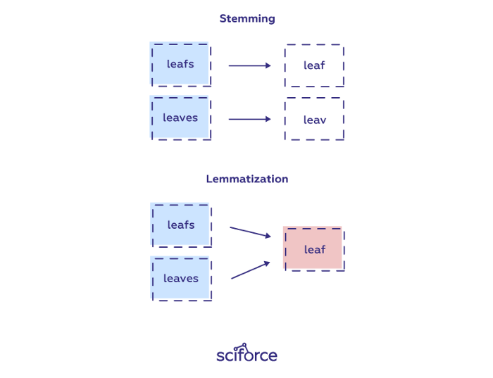
Lemmatization
Lemmatization reduces words to their base word, reducing the inflected words properly and ensuring that the root word belongs to the language. It’s usually more sophisticated than stemming, since stemmers works on an individual word without knowledge of the context.
In lemmatization, a root word is called lemma. A lemma is the canonical form, dictionary form, or citation form of a set of words.

Slide 15
Tf-idf: Term Frequency — Inverse Document Frequency
TF-IDF stands for Term Frequency — Inverse Document Frequency and is a statistic that aims to better define how important a word is for a document, while also taking into account the relation to other documents from the same corpus.
The rationale behind this is the following:
a word that frequently appears in a document has more relevancy for that document, meaning that there is higher probability that the document is about or in relation to that specific word
a word that frequently appears in more documents may prevent us from finding the right document in a collection; the word is relevant either for all documents or for none. Either way, it will not help us filter out a single document or a small subset of documents from the whole set.
So then TF-IDF is a score which is applied to every word in every document in our dataset. And for every word, the TF-IDF value increases with every appearance of the word in a document, but is gradually decreased with every appearance in other documents

Slide 16
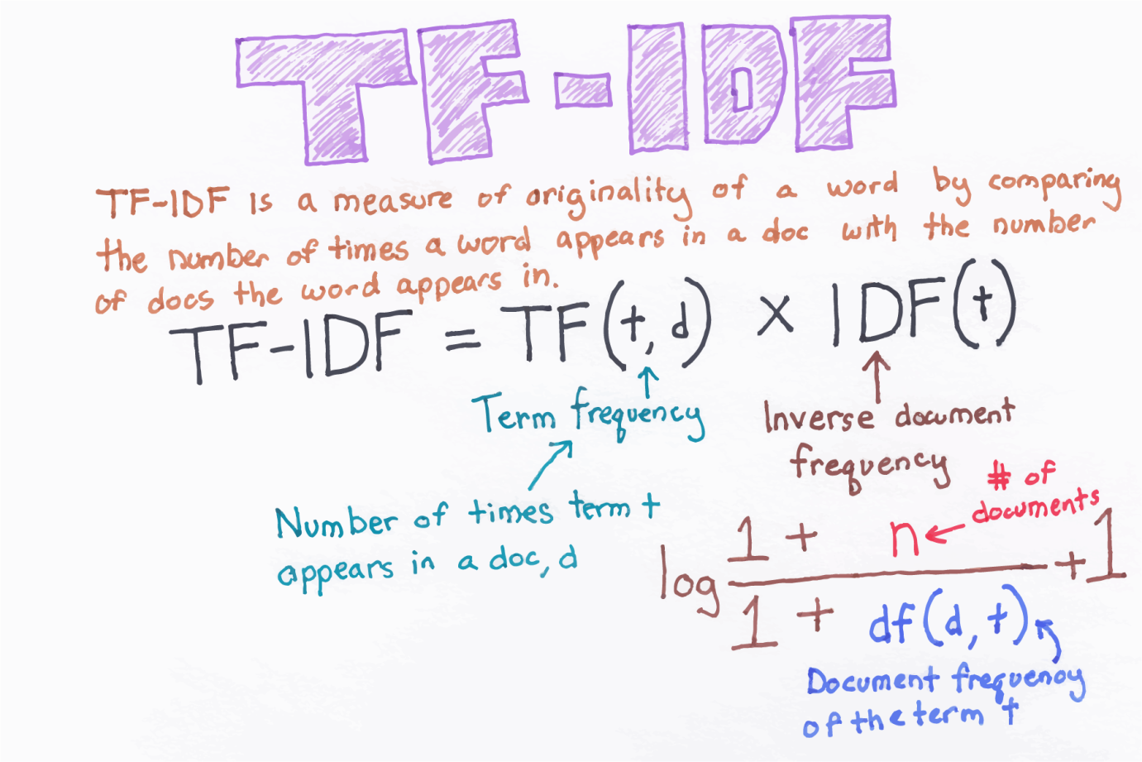
TF-Idf vectorization

Slide 17
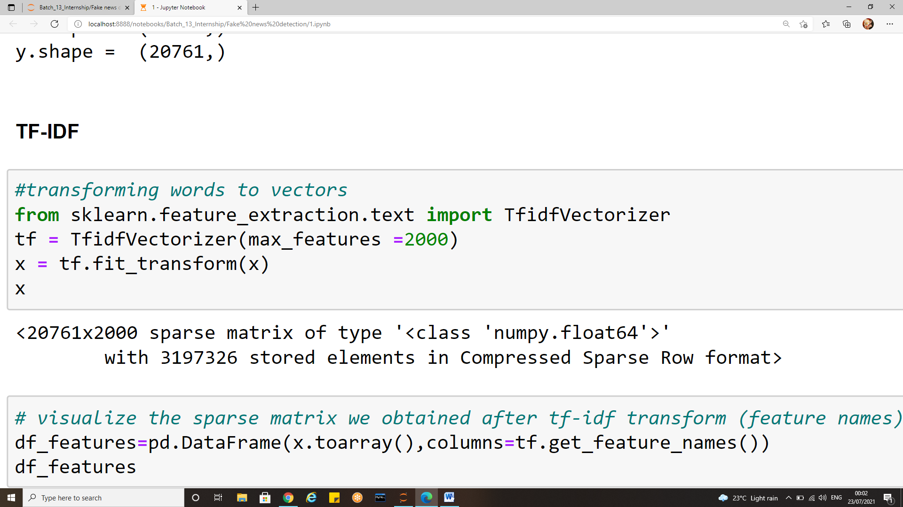
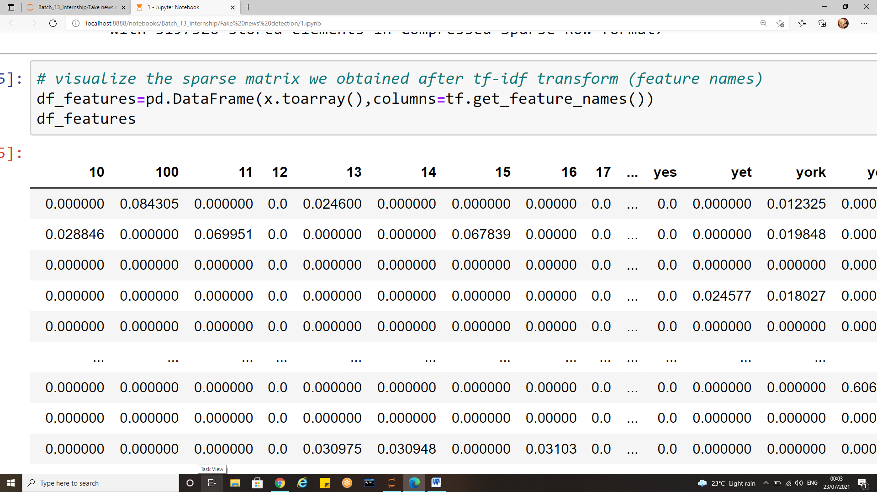
Implementing TF-IDF in python

Slide 18
Data Visualization
Data analysis and data visualization are not entirely exclusive work sets – they co-exist and feed off of each other.
Thus data visualization aids in gaining useful insights from large data and makes it easy to understand.
In the journey from analysis to data-driven outcomes, data visualization plays a very important role of presenting data in a powerful and credible way.
There are many different scenarios where large amounts of data must be displayed to an audience – a business may need to present sales figures to their directors.
A research team may need to display their findings to investors, or a teacher may need to display statistics to their students for example.
Data visualization allows this information to be displayed in an easy to read format that is both attractive and functional.

Slide 19
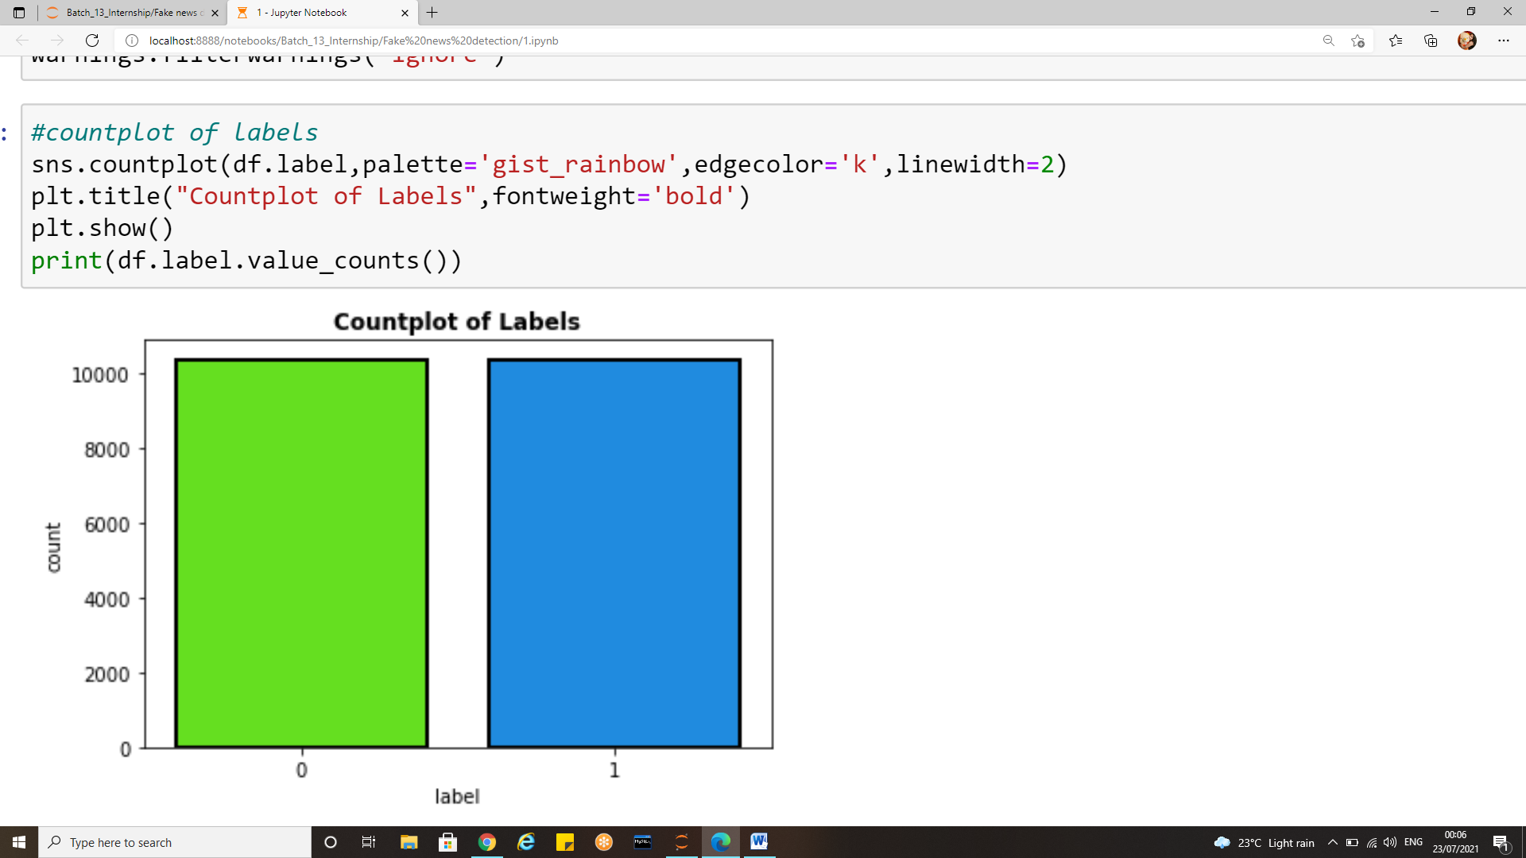
Data visualization
Count plot of each class in the output:
There are 10374 records for fake news(1)
There are 10387 real news(0)

Slide 20
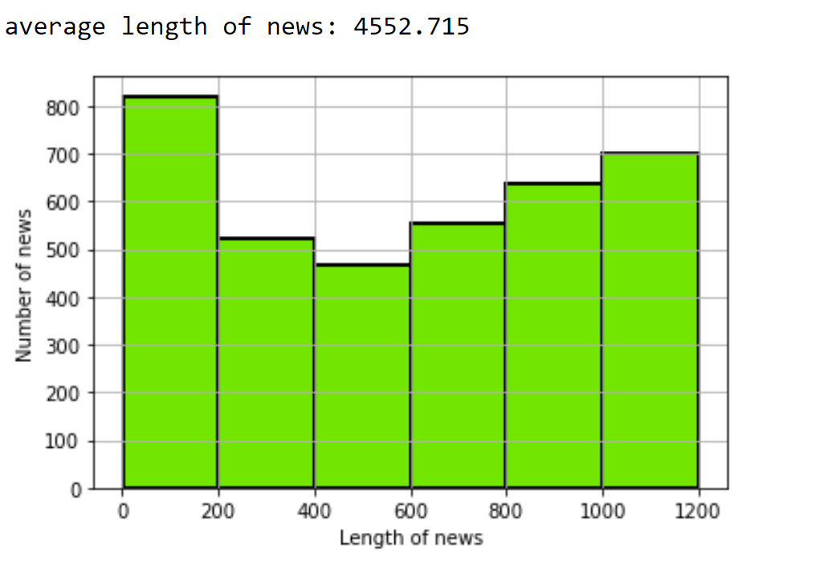
Average length of news

Slide 21
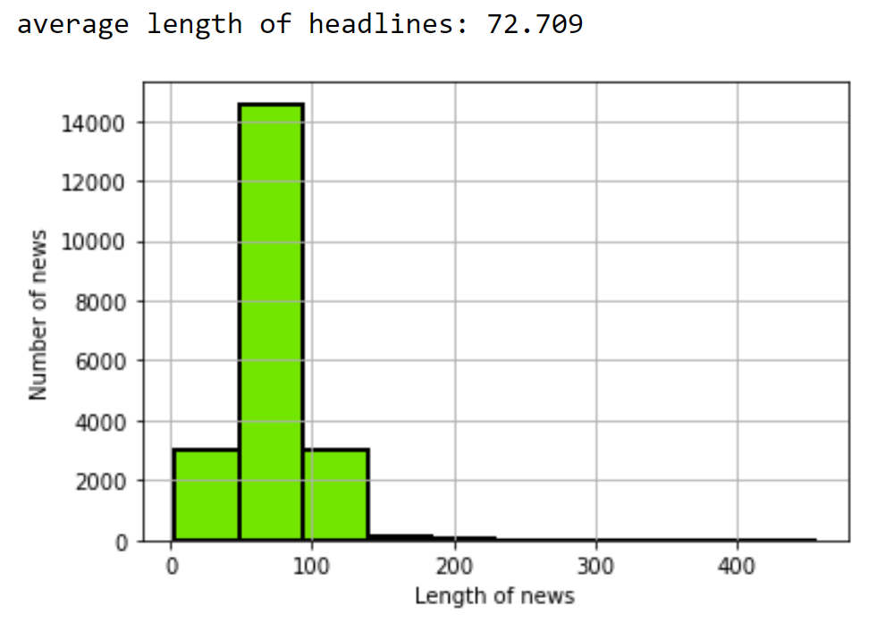
Average length of headlines

Slide 22
Word cloud
Many times you might have seen a cloud filled with lots of words in different sizes, which represent the frequency or the importance of each word. This is called Tag Cloud or WordCloud.
WordCloud is a technique to show which words are the most frequent among the given text. The size of the words represents their frequency. Wordcloud tool is quite handy for exploring text data and making your report livelier.
Each word in this cloud has a variable font size and color tone. Thus, this representation helps to determine words of prominence. A bigger font size of a word portrays its prominence more relative to other words in the cluster.
Word Cloud can be built in varying shapes and sizes based on the creators’ vision. The number of words plays an important role while creating a Word Cloud. More number of words does not always mean a better Word Cloud as it becomes clustery and difficult to read.
A Word Cloud must always be semantically meaningful and must represent what it is meant for.

Slide 23

Wordcloud for headlines

Slide 24
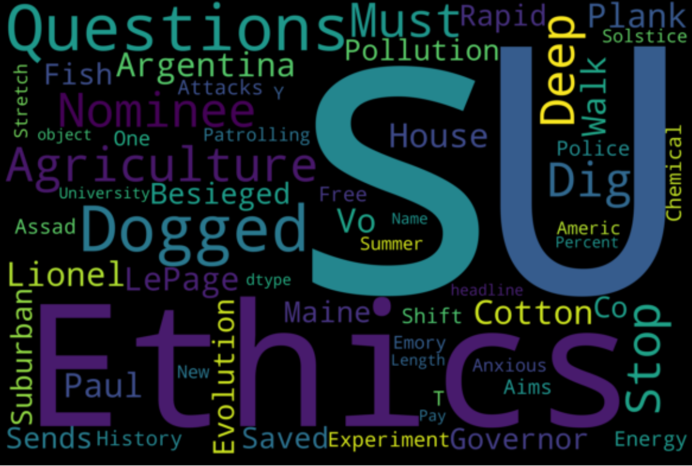
WordCloud for True headlines

Slide 25
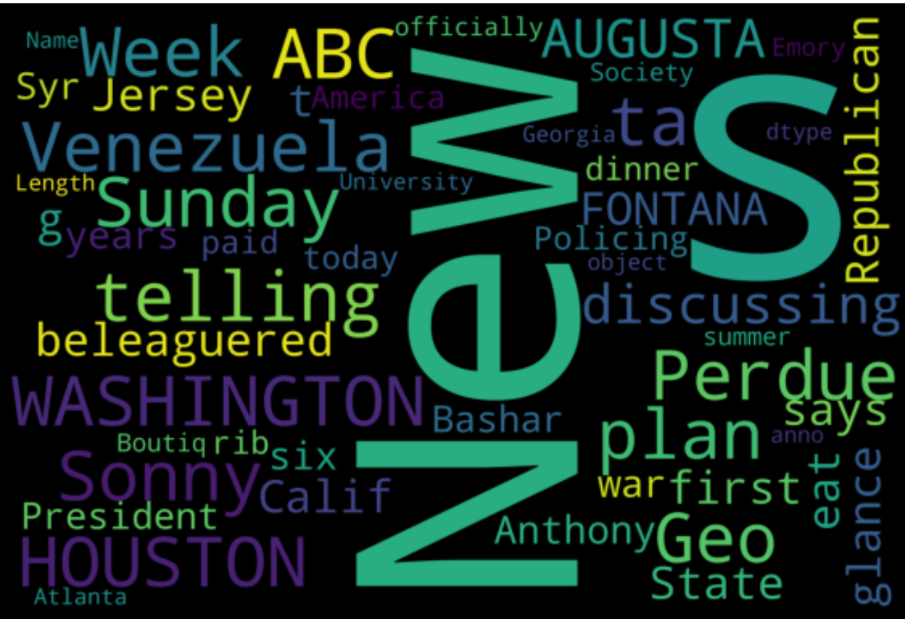
WordCloud for true news

Slide 26
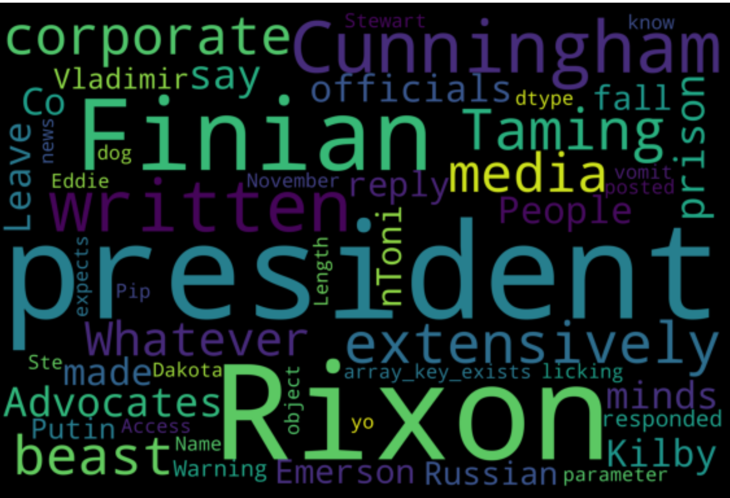
Word cloud for fake news

Slide 27
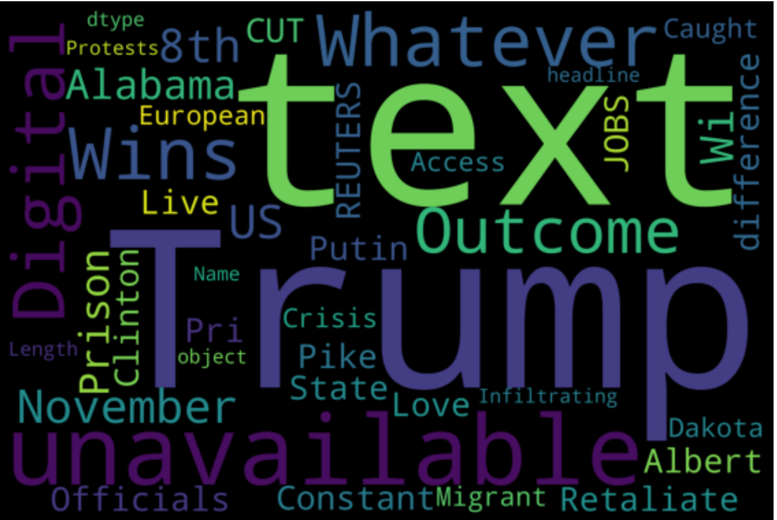
Word cloud for fake headlines

Slide 28
Model Building Steps
We began with exploring the dataset; our aim was to build a model which could classify the news as fake or real on the basis of news and the headline of news.
The dataset had 20800 rows and 6 columns named id, unnamed 0, headline, news, written_by and label. The label was our dependent variable.
There were 558 null values in “headline”column,1957 in “written_by” and 39 Nan values in “news
In order to handle these null values, we decided to drop all 39 nulls in “news” column because there is no use of empty news.
For rest 2 columns i.e. “headline” and “written by” we have substituted a separate text as “text unavailable”

Slide 29
Model Building Steps
The unnamed 0 and id column had unique value for each row hence we decided to drop them as they were of no use.
The next very important step was to carry out the pre-processing on text data in order to transform the raw data into meaningful text and extract useful and relevant information from the text available.
Various user defined functions were created to clean up text: remove_punctautions, cleaning, remove_emojis, remove_html etc.
The later part included stop words removal and lemmatization.
Once we were ready with clean text data, the next step was to transform the entire textual data into some vectors as our machines could only interpret numbers.
Tfidf was implemented to achieve the vectors for textual data

Slide 30
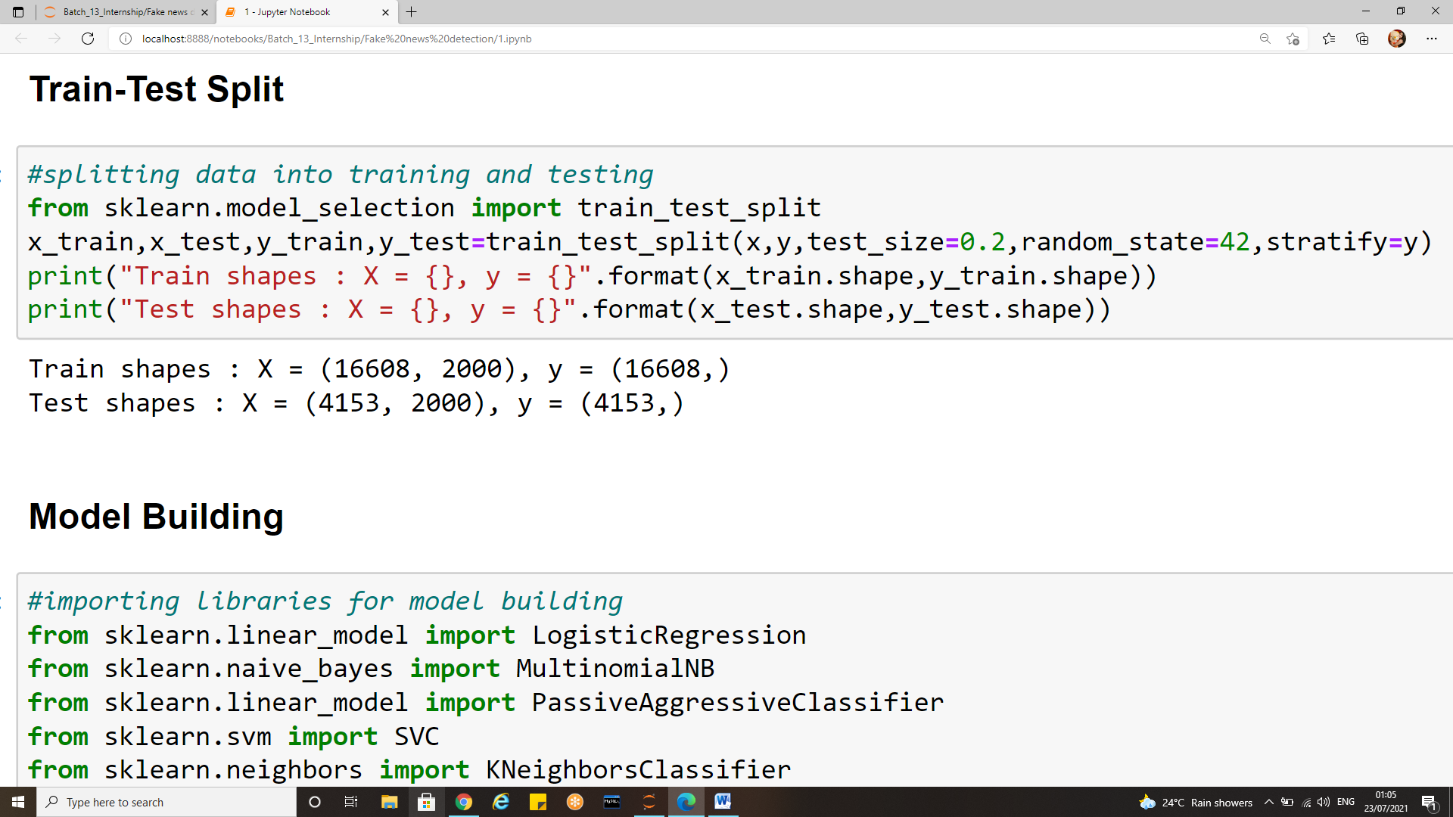
Model Building Steps
The tfidf was then performed on “X” and “label” column was passed to y variable.
Then we made a train –test split with 80% of data for training and remaining 20% was the test data. A random state of 42 was randomly chosen with stratify for label.
The x and y train and test shapes can be seen is above snap.
Various algorithms were then implemented to find out the best among all.

Slide 31
Algorithms and evaluation metrics used
Algorithms used
Logistic Regression
Passive aggressive classifier
KNN
Multinomial
SVC
Gradient Boosting classifier
Evaluations metrics studied:
Accuracy score
Cross validation scores
Classification reports
Confusion matrix
Auc Roc score

Slide 32
Understanding the Evaluation metrics
Choosing the right metric is crucial while evaluating machine learning (ML) models.
Various metrics are proposed to evaluate ML models in different applications .
In some applications looking at a single metric may not give you the whole picture of the problem you are solving, and you may want to use a subset of the metrics.
There are various ways to evaluate a classification model, and we will be covering some of the most popular ones.

Slide 33
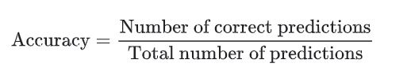
Classification Accuracy
Classification accuracy is perhaps the simplest metrics one can imagine, and is defined as the number of correct predictions divided by the total number of predictions, multiplied by 100.
For an example, if out of 1100 samples 1030 are predicted correctly, the classification accuracy can be given as :
Classification accuracy= 1030/1100= 93.6%
It works well only if there are equal number of samples belonging to each class.

Slide 34
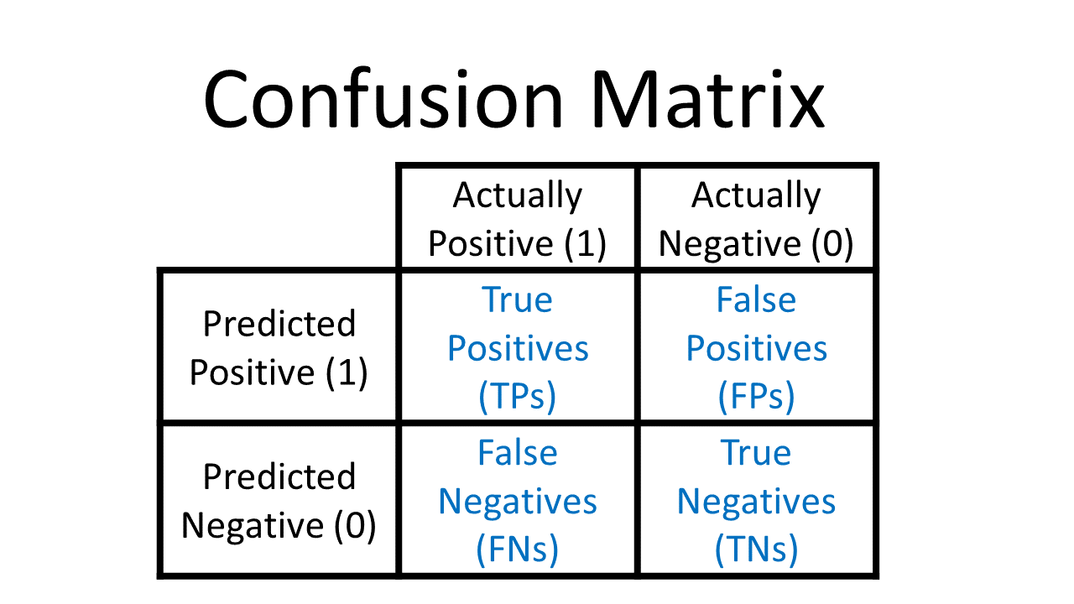
Confusion matrix
TRUE POSITIVE: measures the proportion of actual positives that are correctly identified.
TRUE NEGATIVE: measures the proportion of actual positives that are not correctly identified.
FALSE POSITIVE: measures the proportion of actual negatives that are correctly identified.
FALSE NEGATIVE: measures the proportion of actual negatives that are not correctly identified.

Slide 35
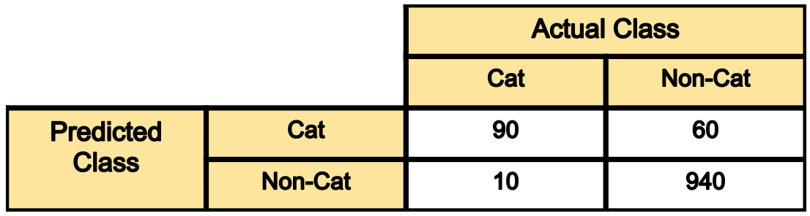
Example of confusion matrix
Let’s assume we are building a binary classification to classify cat images from non-cat images.
And let’s assume our test set has 1100 images (1000 non-cat images, and 100 cat images), with the below confusion matrix.

Slide 36
Example of confusion matrix
Out of 100 cat images the model has predicted 90 of them correctly and has mis-classified 10 of them.
If we refer to the “cat” class as positive and the non-cat class as negative class, then 90 samples predicted as cat are considered as a true-positive, and the 10 samples predicted as non-cat are false negative.
Out of 1000 non-cat images, the model has classified 940 of them correctly, and mis-classified 60 of them.
The 940 correctly classified samples are referred as true-negative, and those 60 are referred as false-positive.
As we can see diagonal elements of this matrix denote the correct prediction for different classes, while the off-diagonal elements denote the samples which are mis-classified.

Slide 37
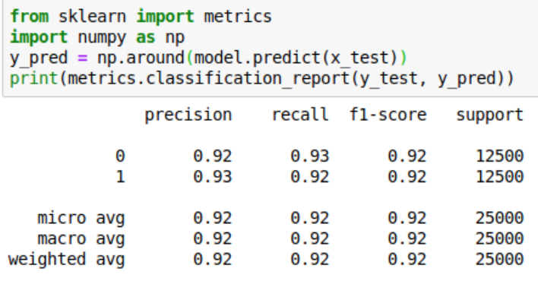
Classification report
The classification report visualizer displays the precision, recall, F1, and support scores for the model.
An example of classification report is shown below:

Slide 38
Terminologies related to classification report
There are four ways to check if the predictions are right or wrong:
TN / True Negative: the case was negative and predicted negative
TP / True Positive: the case was positive and predicted positive
FN / False Negative: the case was positive but predicted negative
FP / False Positive: the case was negative but predicted positive

Slide 39

Precision
Precision — What percent of your predictions were correct?
Precision is the ability of a classifier not to label an instance positive that is actually negative.
For each class, it is defined as the ratio of true positives to the sum of a true positive and false positive.
Precision:- Accuracy of positive predictions.

Slide 40
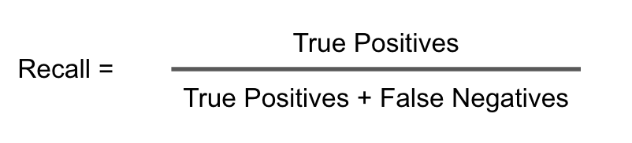
Recall
Recall — What percent of the positive cases did you catch?
Recall is the ability of a classifier to find all positive instances. For each class it is defined as the ratio of true positives to the sum of true positives and false negatives.
Recall:- Fraction of positives that were correctly identified.
Recall = TP/(TP+FN)

Slide 41
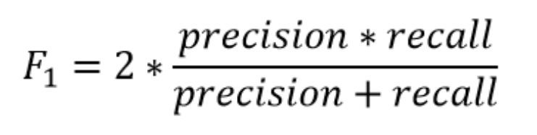
F1 score
F1 score — What percent of positive predictions were correct?
The F1 score is a weighted harmonic mean of precision and recall such that the best score is 1.0 and the worst is 0.0. F1 scores are lower than accuracy measures as they embed precision and recall into their computation.
As a rule of thumb, the weighted average of F1 should be used to compare classifier models, not global accuracy.
F1 Score = 2*(Recall * Precision) / (Recall + Precision)

Slide 42
Support
Support is the number of actual occurrences of the class in the specified dataset.
Imbalanced support in the training data may indicate structural weaknesses in the reported scores of the classifier and could indicate the need for stratified sampling or rebalancing.
Support doesn’t change between models but instead diagnoses the evaluation process.

Slide 43
AUC ROC CURVE
The Receiver Operator Characteristic (ROC) curve is an evaluation metric for binary classification problems. It is a probability curve that plots the TPR against FPR at various threshold values and essentially separates the ‘signal’ from the ‘noise’.
The Area Under the Curve (AUC) is the measure of the ability of a classifier to distinguish between classes and is used as a summary of the ROC curve.
The higher the AUC, the better the performance of the model at distinguishing between the positive and negative classes.

Slide 44
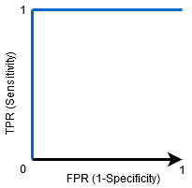
AUC ROC Curve
When AUC = 1, then the classifier is able to perfectly distinguish between all the Positive and the Negative class points correctly. If, however, the AUC had been 0, then the classifier would be predicting all Negatives as Positives, and all Positives as Negatives.

Slide 45
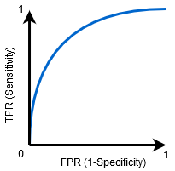
AUC-ROC Curve
When 0.5<AUC<1, there is a high chance that the classifier will be able to distinguish the positive class values from the negative class values. This is so because the classifier is able to detect more numbers of True positives and True negatives than False negatives and False positives.

Slide 46
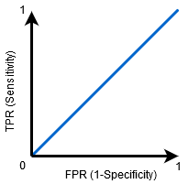
AUC-ROC Curve
When AUC=0.5, then the classifier is not able to distinguish between Positive and Negative class points. Meaning either the classifier is predicting random class or constant class for all the data points.
So, the higher the AUC value for a classifier, the better its ability to distinguish between positive and negative classes.

Slide 47
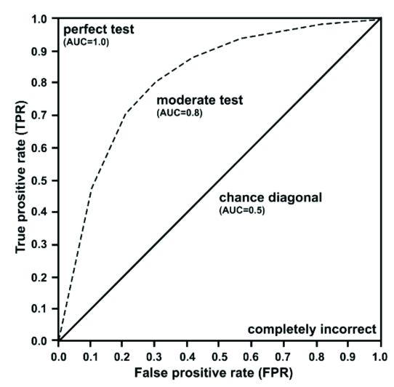
Concluding AUC-ROC Curve
Thus area under the curve is used to access the overall accuracy of model
Value of 1- High sensitivity and specificity
Value of 0- Zero diagnostic capability.

Slide 48
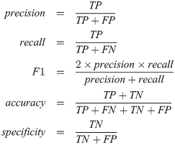
A quick overview of the formulae's
Thus we can summarise all the metrics as below:

Slide 49
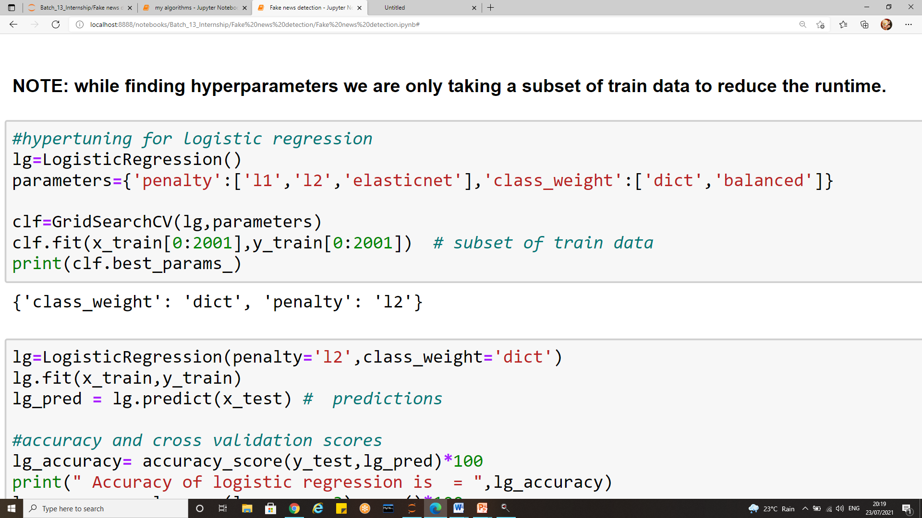
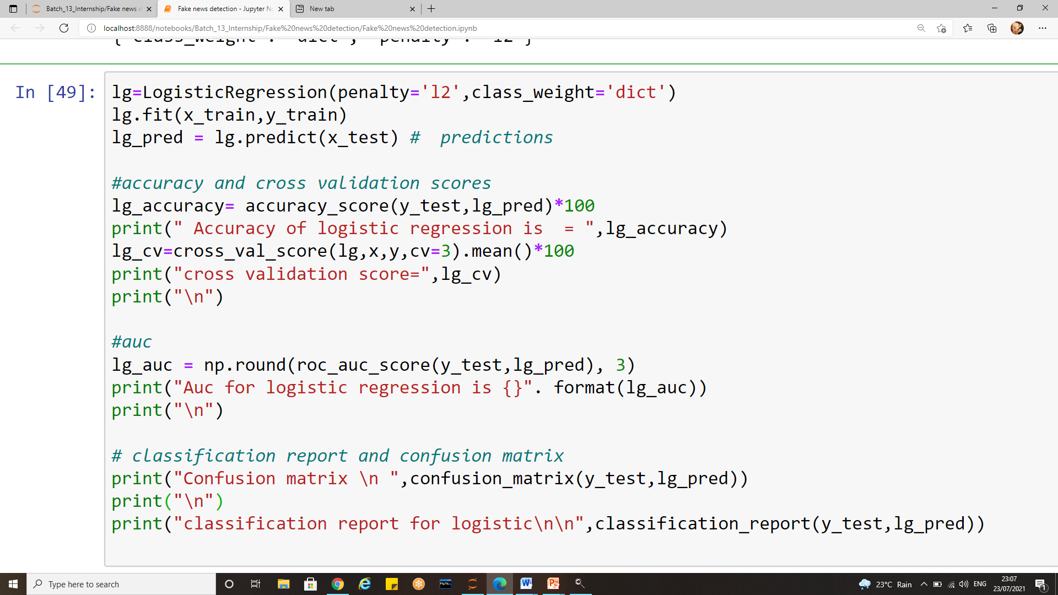
1) Logistic Regression implementation

Slide 50
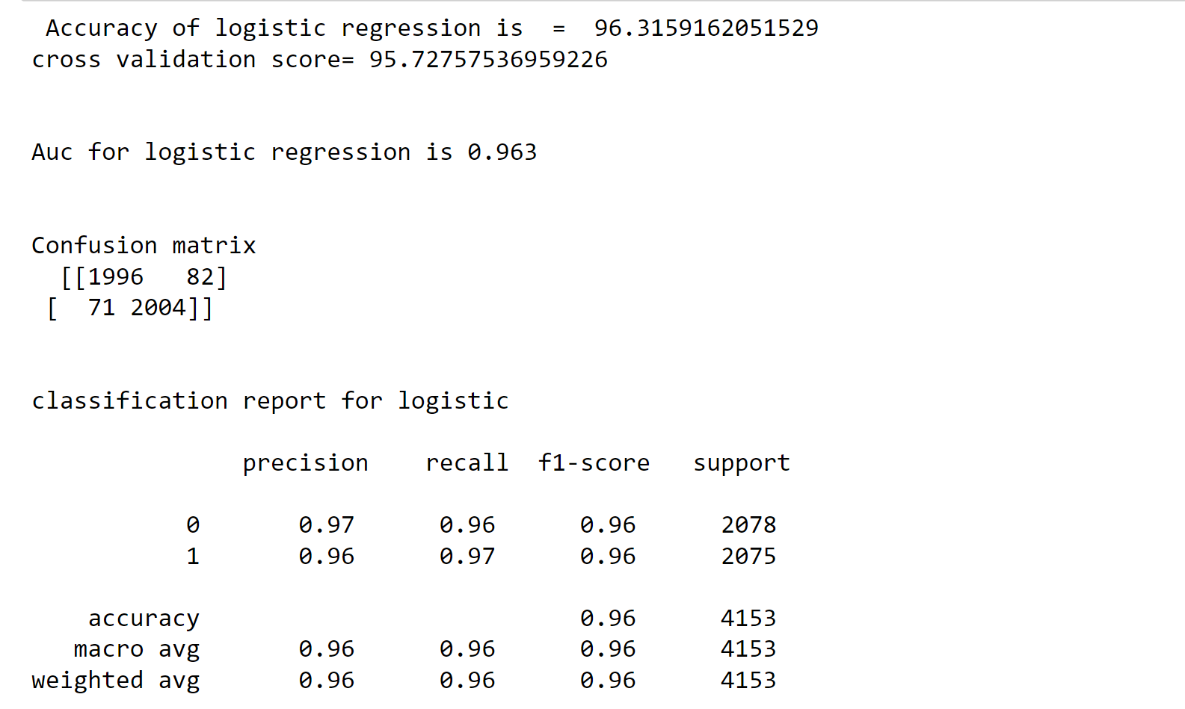
Logistic Regression Evaluation

Slide 51
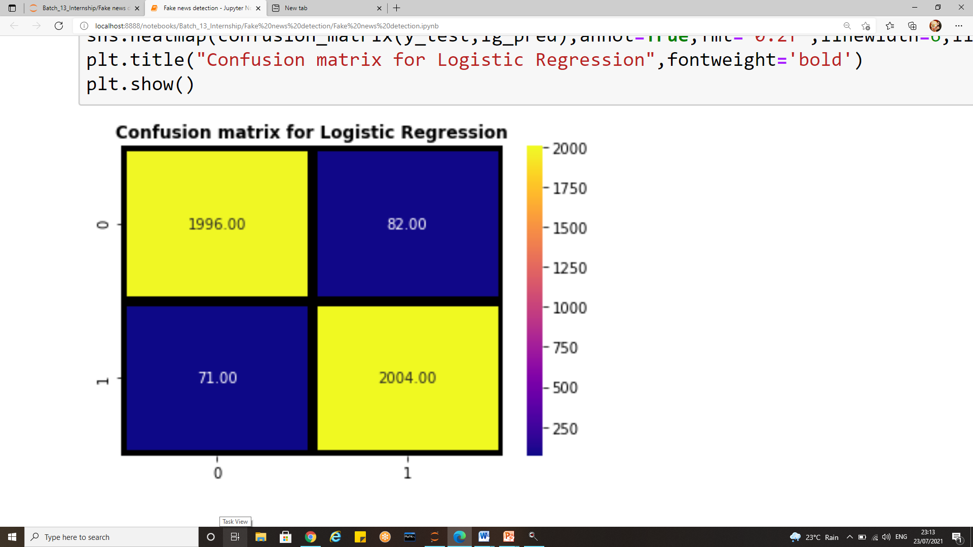
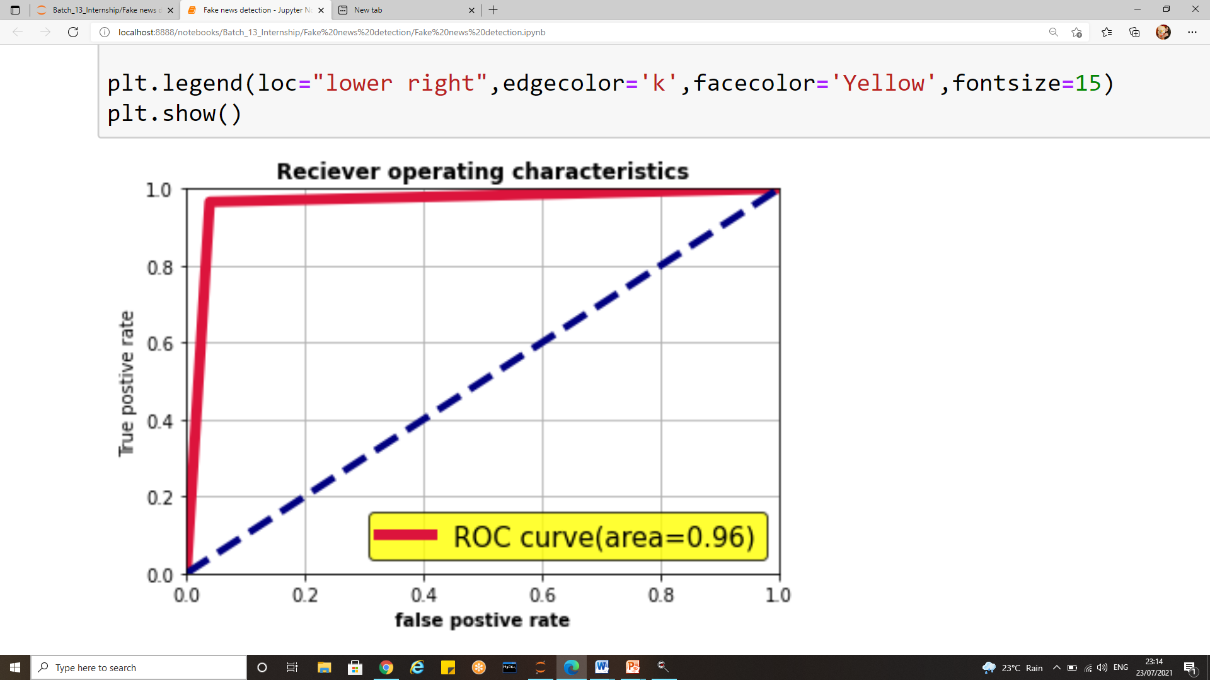
Logistic regression Evaluation
Confusion matrix
Auc Roc curve

Slide 52
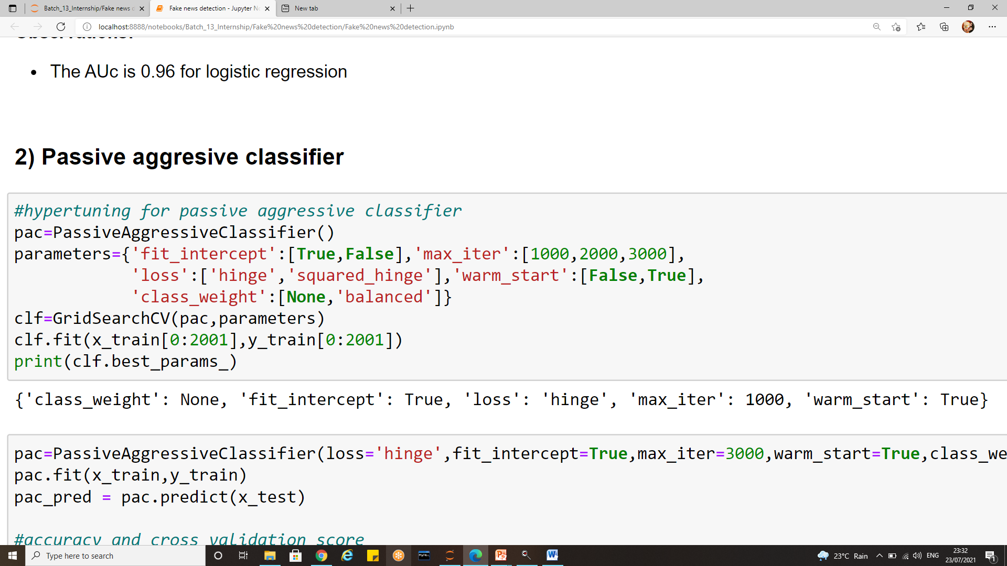
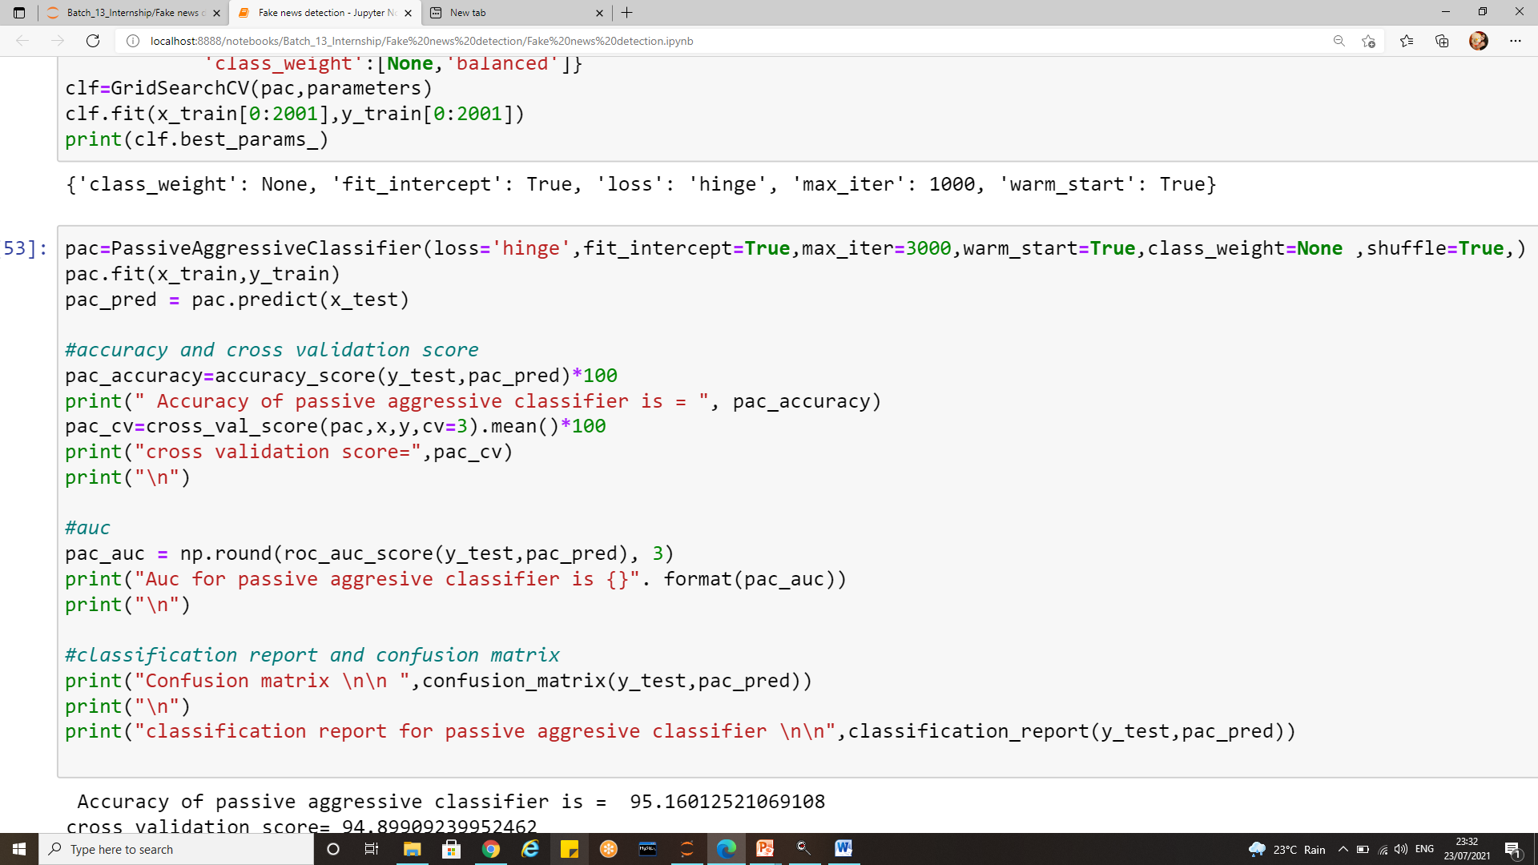
2) Passive aggressive classifier implementation

Slide 53
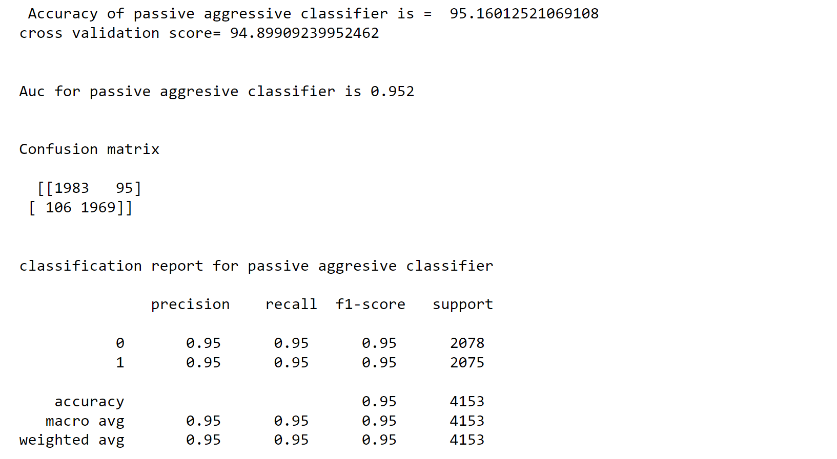
Passive aggressive classifier Evaluation

Slide 54
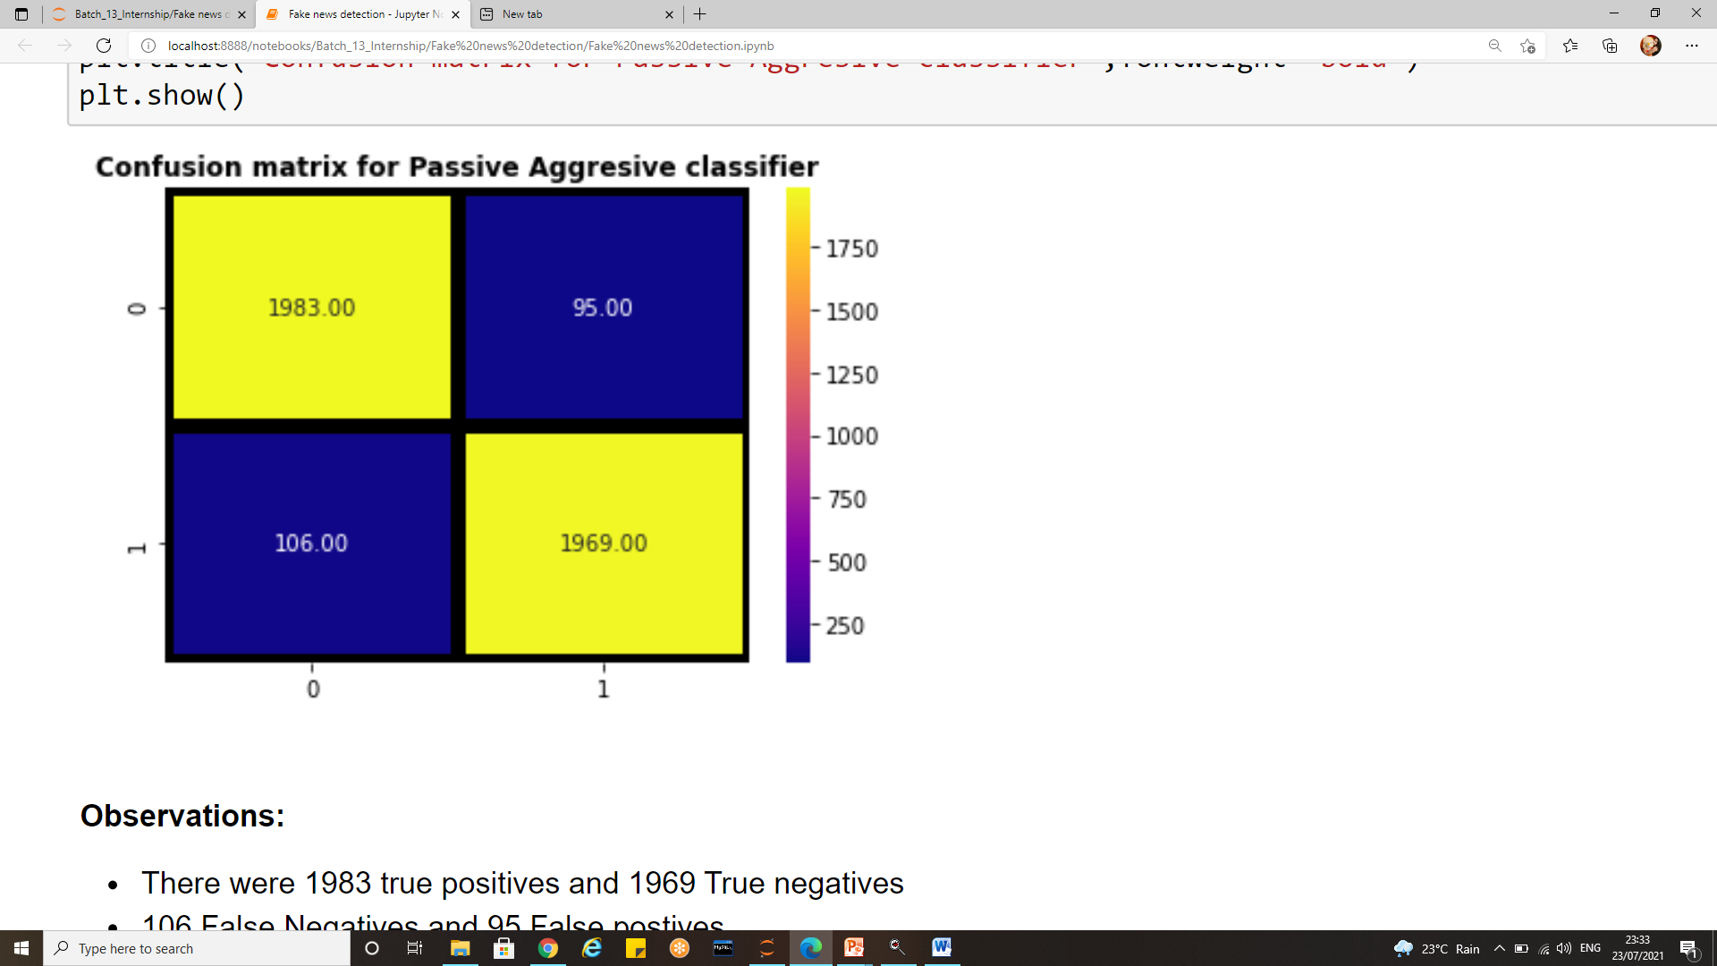
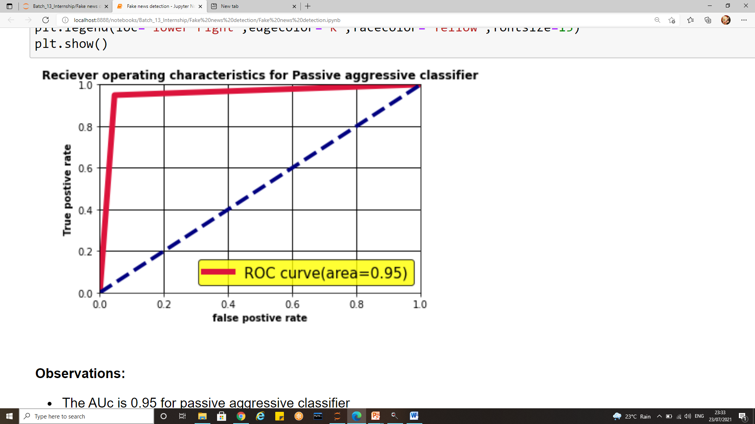
Passive aggressive classifier Evaluation
confusion matrix
Auc roc curve

Slide 55
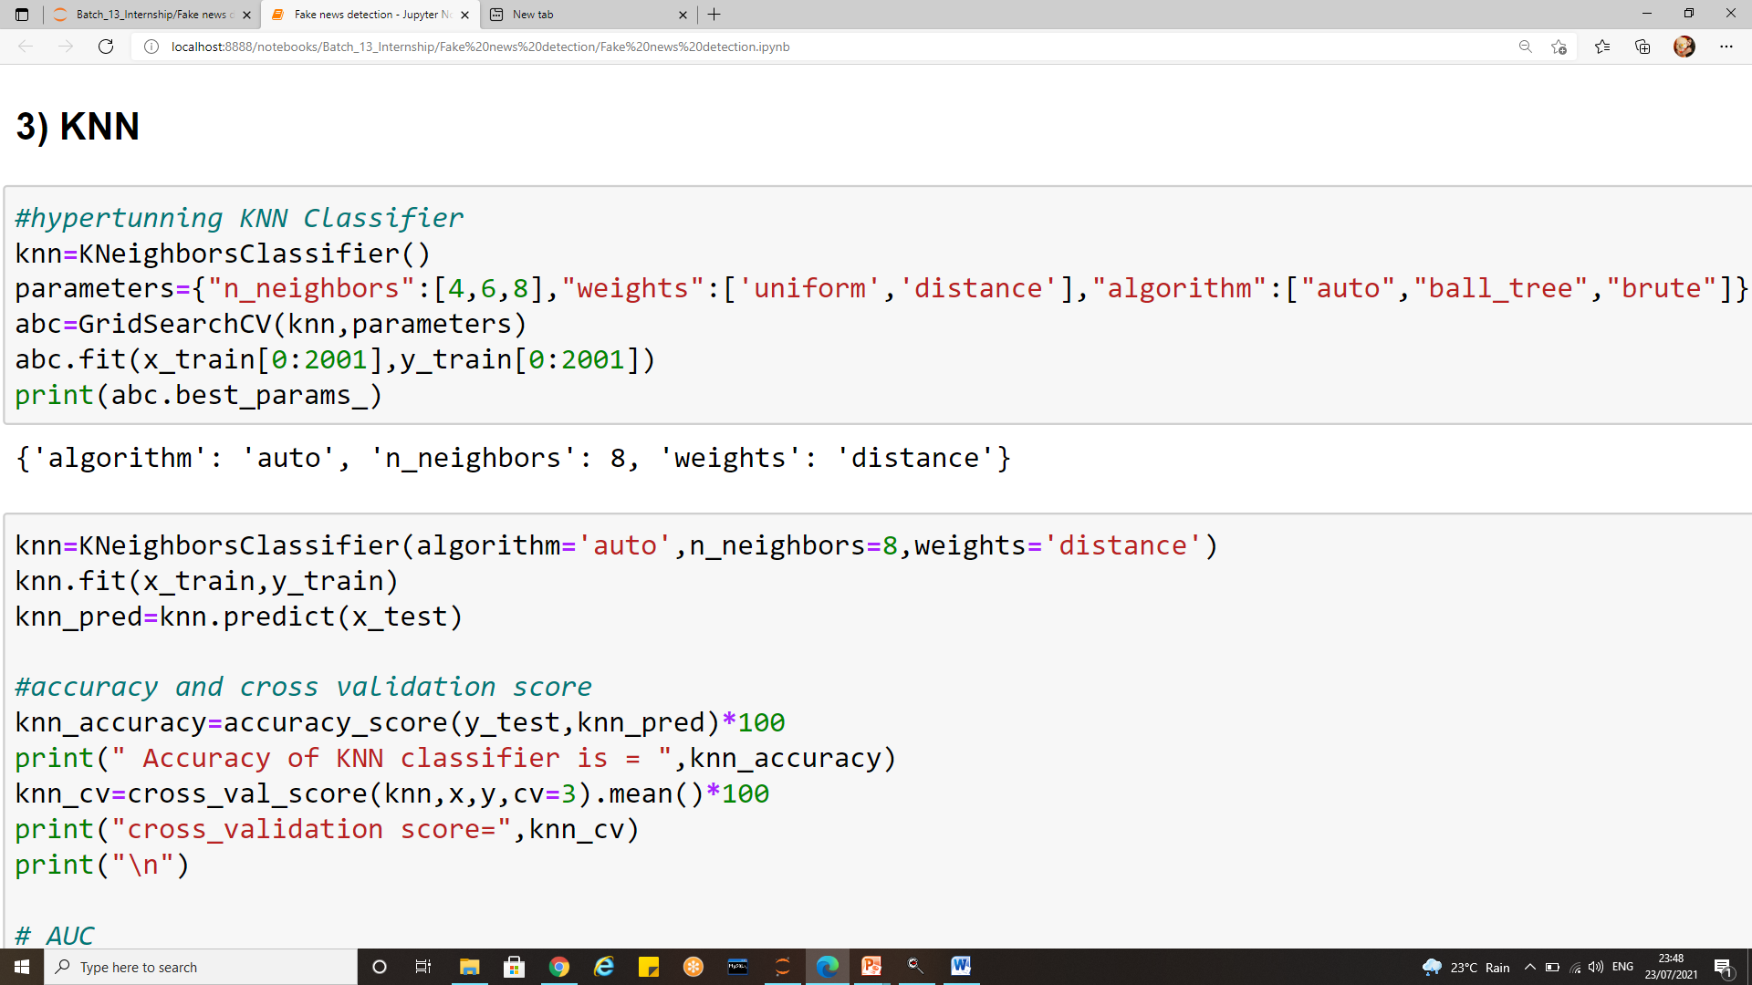
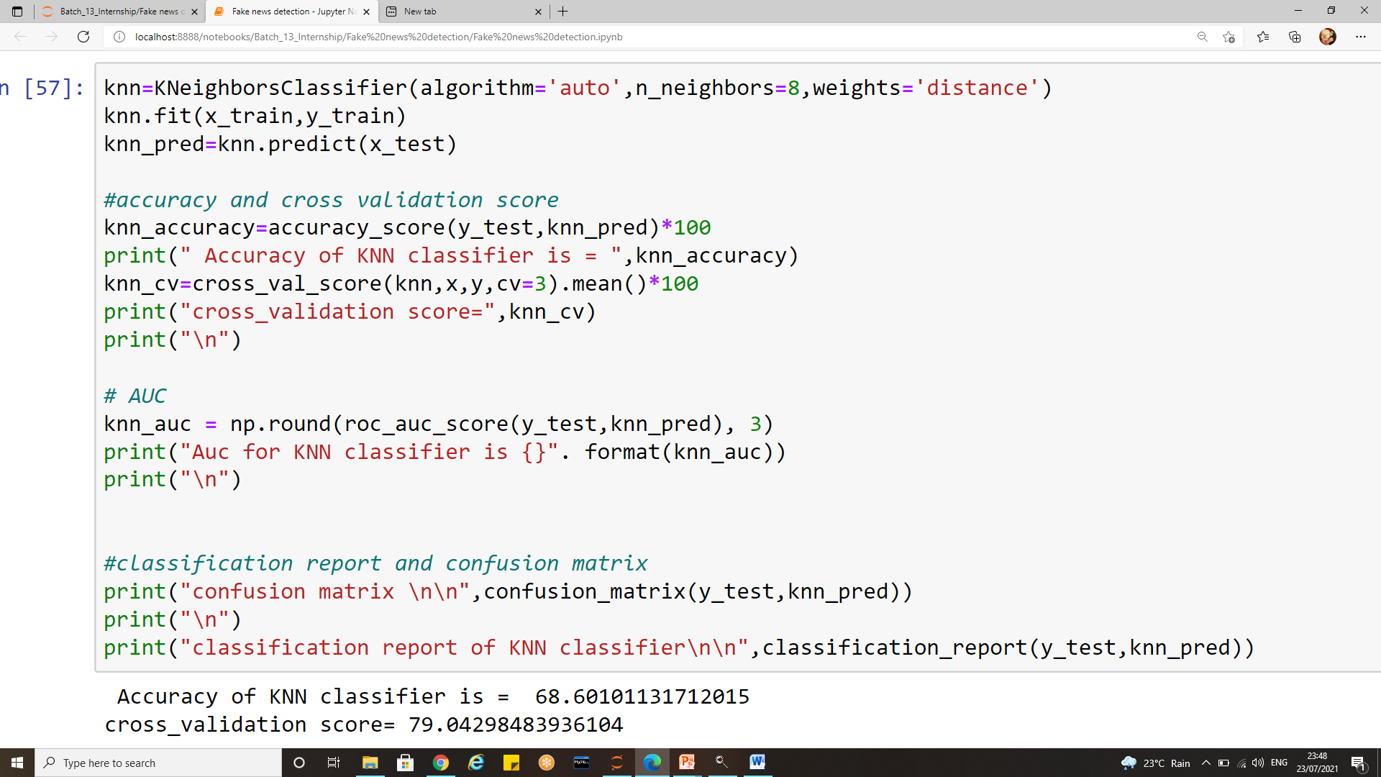
3) Kneighbors classifier implementation

Slide 56
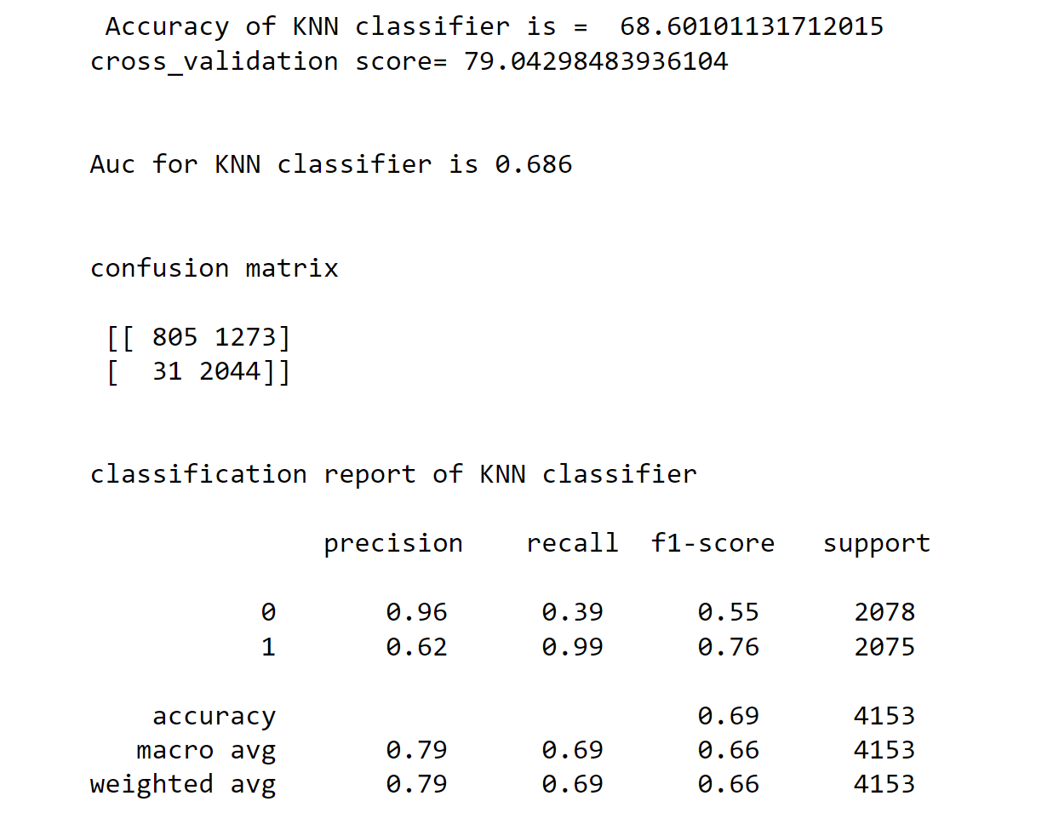
Kneighbors classifier evaluation

Slide 57
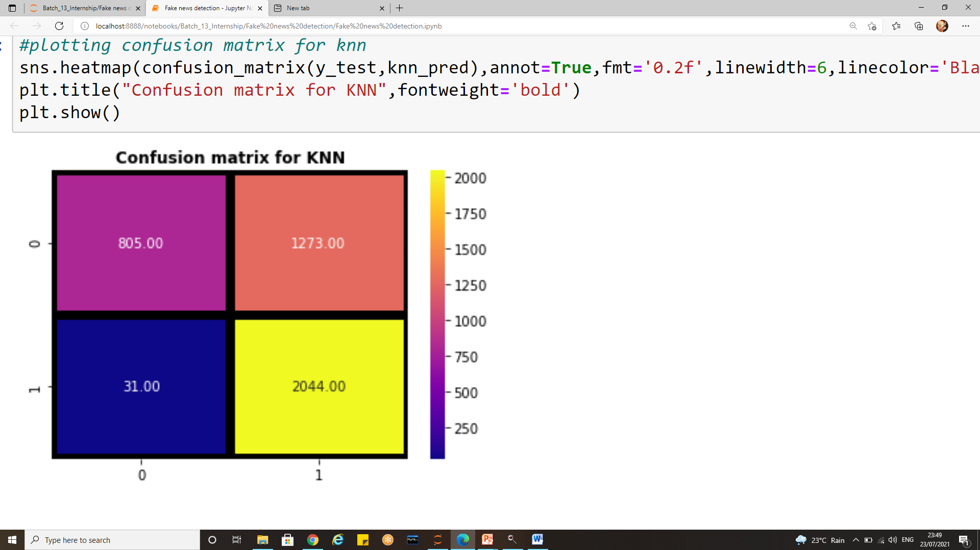
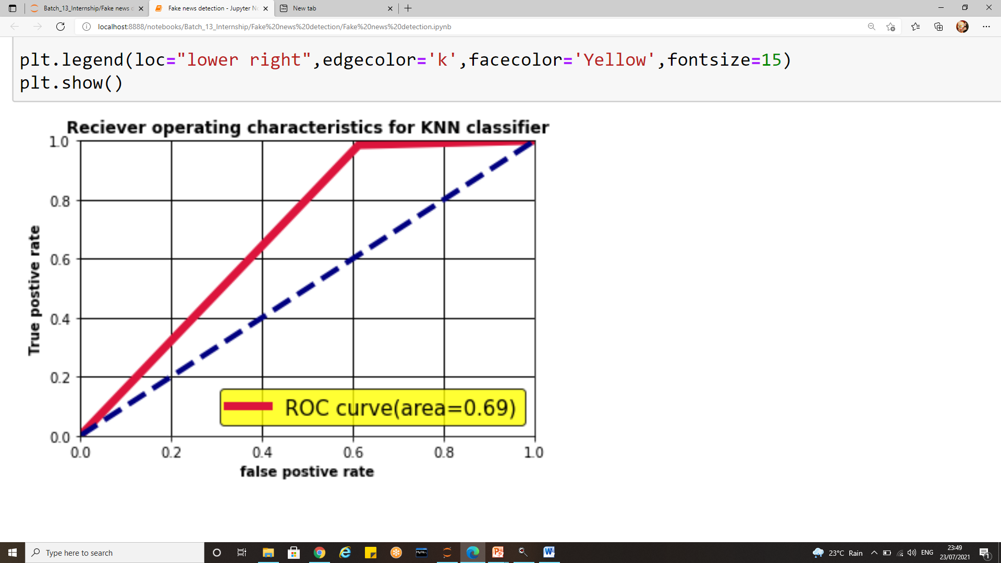
Kneighbors classifier evaluation
Confusion matrix
Auc Roc curve

Slide 58
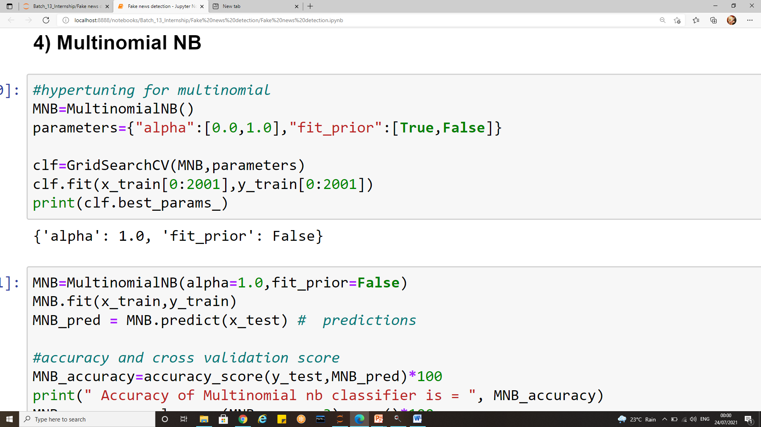
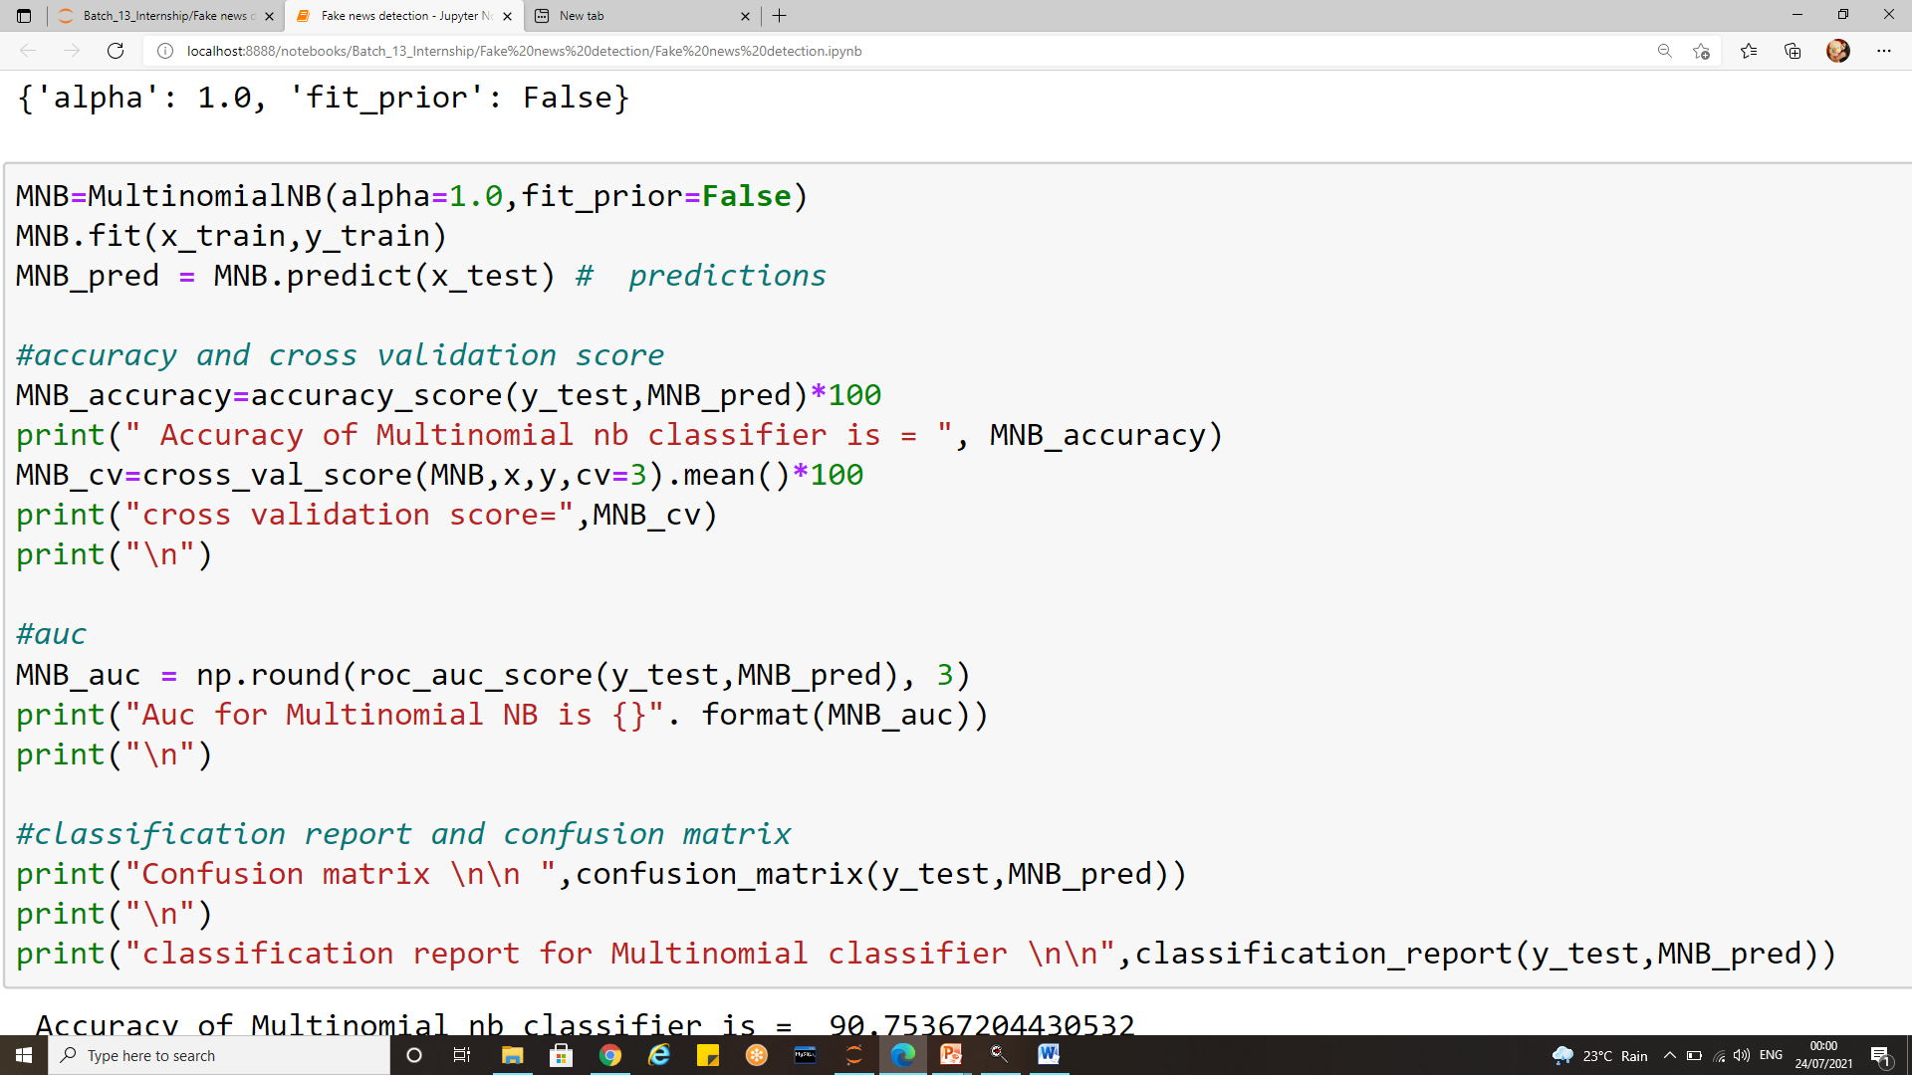
4) Multinomial NB

Slide 59
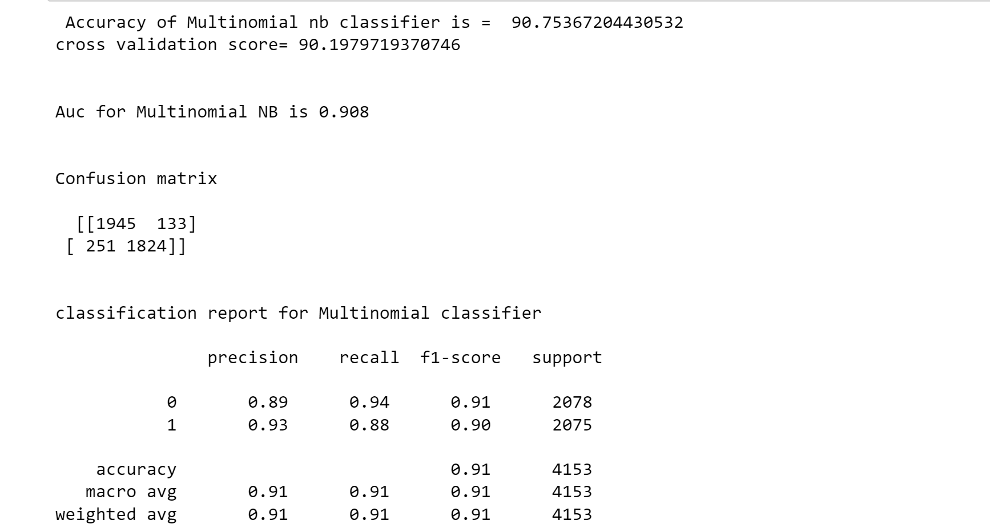
Multinomial NB evaluation

Slide 60
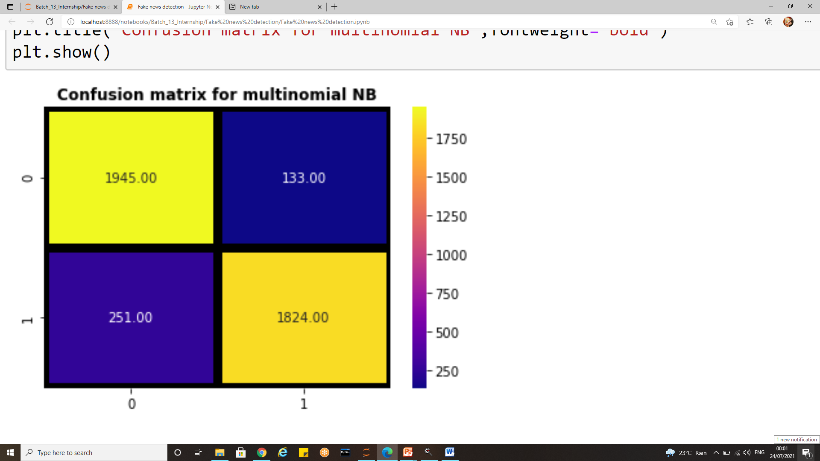
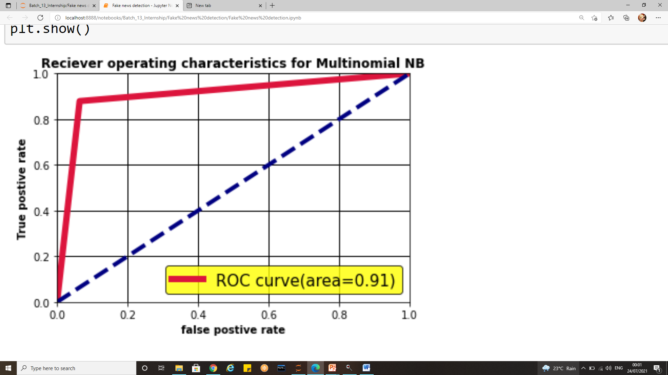
Multinomial NB evaluation
Confusion matrix
Auc Roc curve

Slide 61
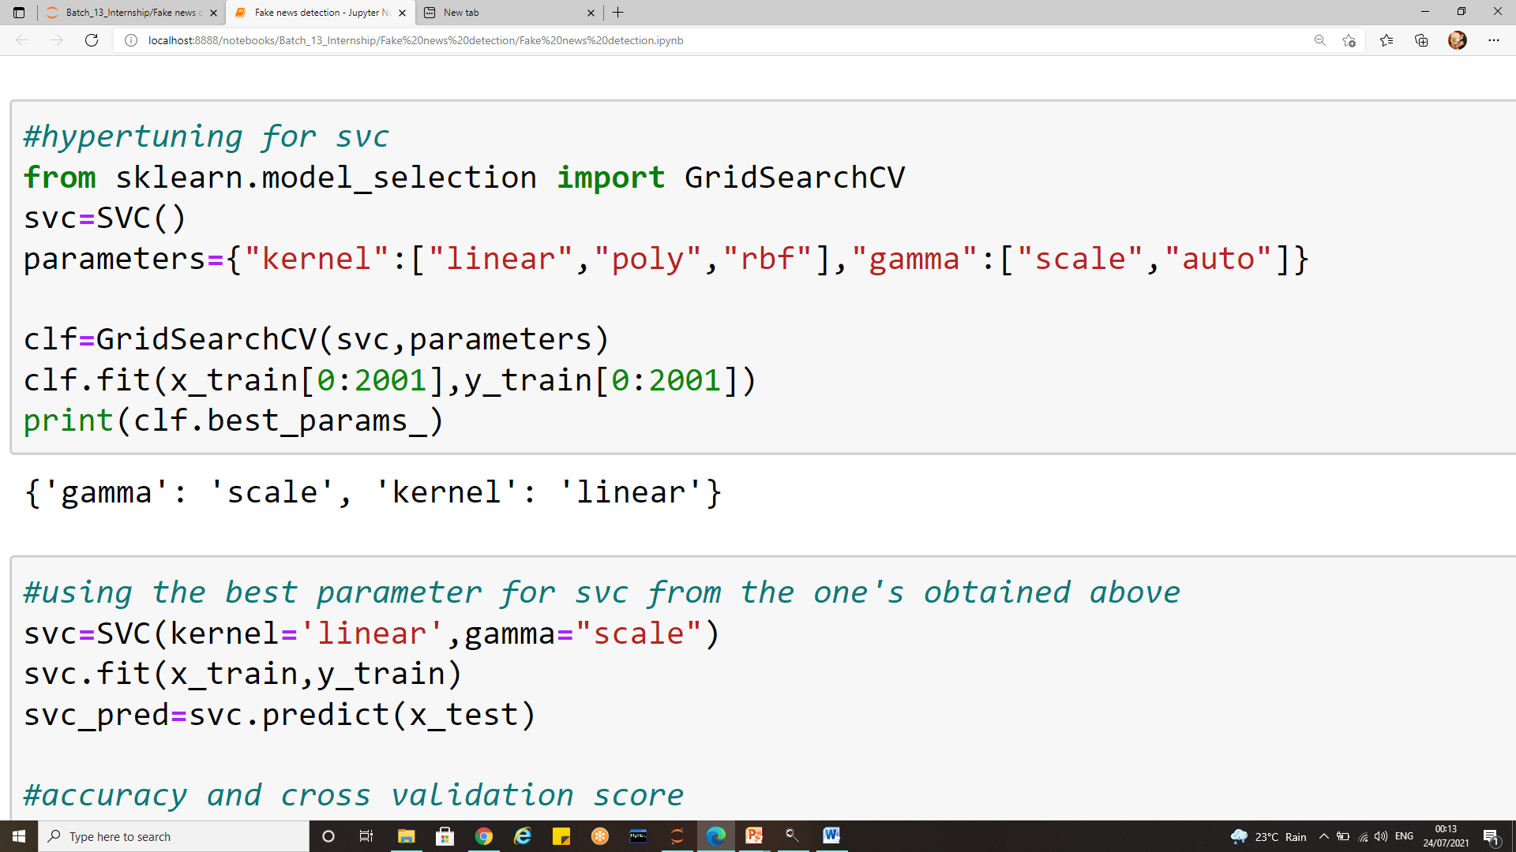
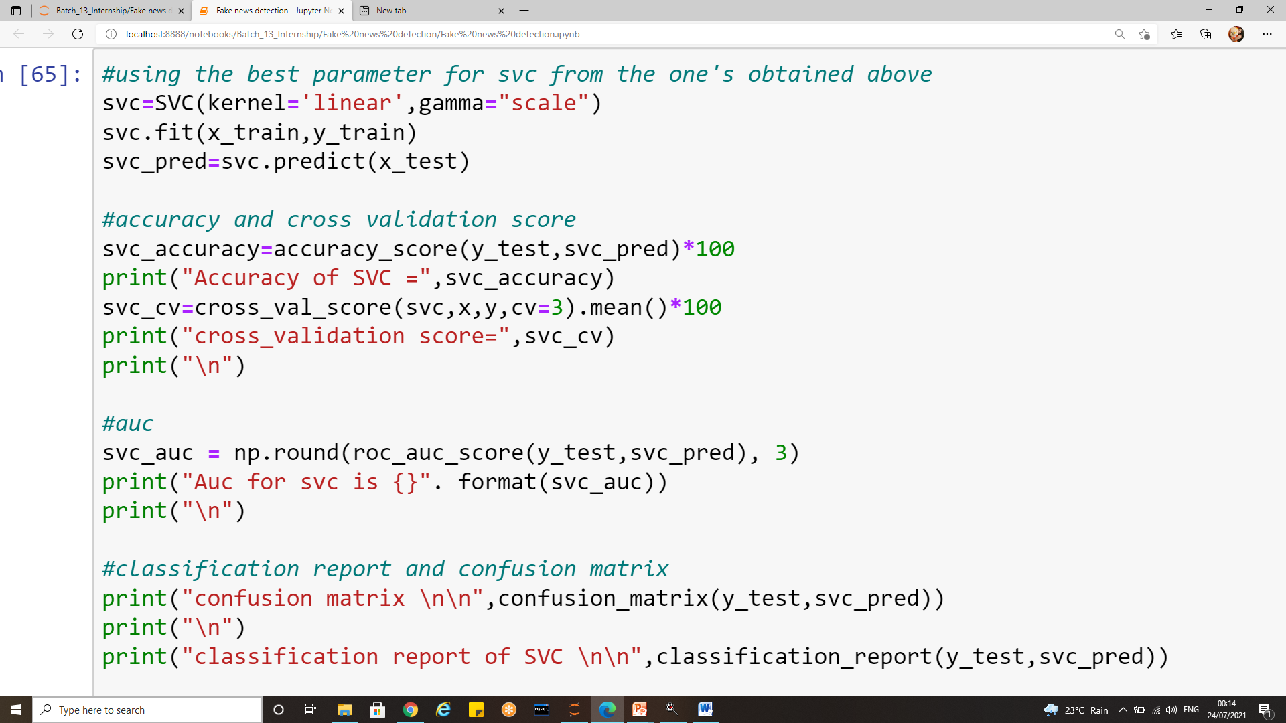
5) Svc implementation

Slide 62
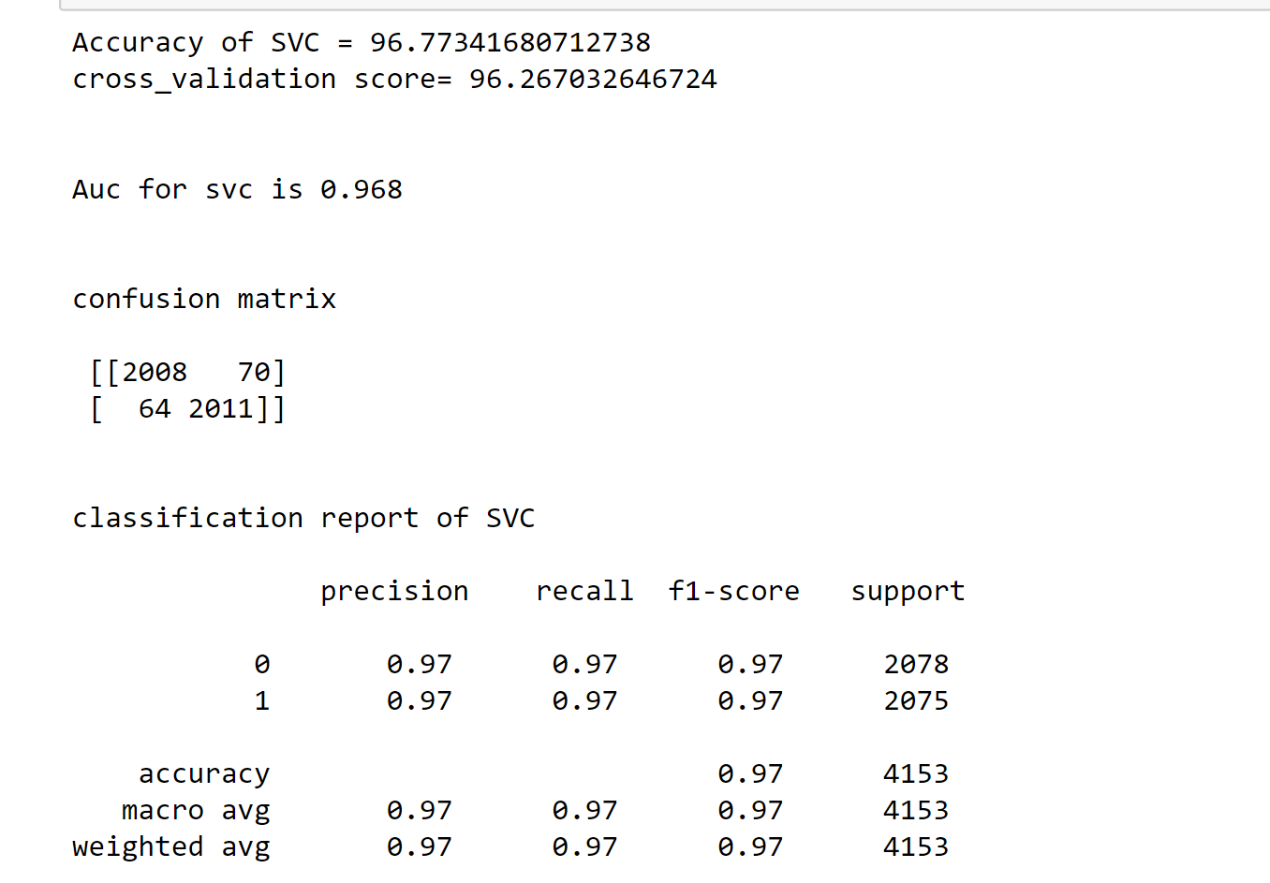
SVC Evaluation

Slide 63


SVC Evaluation
Confusion matrix
Auc Roc Curve

Slide 64


6) Gradient Boosting classifier

Slide 65

Gradient Boosting classifier evaluation

Slide 66


Gradient Boosting classifier evaluation
Confusion matrix
Auc Roc curve

Slide 67

Comparing all the algorithms

Slide 68
Conclusion
Advances in technology and the spread of news through different types of media have increased the spread of fake news today. One of the principal problems is that receivers believe anything sent to them over social media due to lack of awareness.
The task of classifying news manually requires in-depth knowledge of the domain and expertise to identify anomalies in the text.
In the discourse of not being able to detect fake news, the world would no longer hold value in truth.
These fake news can be propaganda against an individual, society, organization or political party. Information veracity is a long-term issue affecting society both for printed and digital media.
A human being is unable to detect all these fake news. So there is a need for machine learning classifiers that can detect this fake news automatically.
Hence the problem has been taken over and resolved with the help of Natural Language Processing tools which help us identify fake or true news based on historical data. The news is now in safe hands!

Slide 69
Conclusion
The main contribution of this project is support for the idea that machine learning could be useful in a novel way for the task of classifying fake news.
This project work makes an analysis of the research related to fake news detection and explores the traditional machine learning models to choose the best, in order to create a model of a product with supervised machine learning algorithm, that can classify fake news as true or false, by using tools like python scikit-learn, NLP for textual analysis.
In this report, we discussed the problem of classifying fake news articles using machine learning models and few ensemble techniques.
The primary aim was to identify patterns in text that differentiate fake articles from true news. We extracted different textual features from the articles using an Tfidf and used the feature set as an input to the models.
The learning models were trained and parameter-tuned to obtain optimal accuracy and achieve an optimal balance between variance and bias. Some models have achieved comparatively higher accuracy than others.

Slide 70
Conclusion
Each model is trained multiple times with a set of different parameters using a grid search to optimize the model for the best outcome. Using a grid search to find the best parameters is computationally expensive however, the measure is taken to ensure the models do not over fit or under fit the data.
We used multiple performance metrics to compare the results for each algorithm. The SVC has shown an overall better score on all performance metrics as compared to others.
Based on the recall and precision performance metric, SVC classifier stands best by achieving a recall score of 0.97. This is closely followed by Gradient boosting classifier) and logistic regression which achieved a recall of 0.96.
SVC is giving us the highest accuracy of 96.77 which is validated with a cross validation of 96.26 which says it does over fit the model.
Logistic Regression could be seen giving similar accuracy to that of SVC but logistic regression shows very little over fit as the accuracy score is slightly greater than cross validation.

Slide 71
Conclusion
The true positives for logistic are 1996 while for Svc are 2008.The true negatives for logistic regression are 2004 while for SVC there are 2011 true negatives.
The total numbers of errors for Logistic are 153 while for SVC there are 124 errors. Hence we used confusion matrix as a deciding factor between Logistic regression and SVC and finalized SVC as our best working model.
Among all the six algorithms KNN had very poor evaluation metrics with an accuracy of only 68.60 % and cross validation of 79% which states the model was over fitting also the precision and recall values were unsatisfactory.
Therefore SVC was finalized and saved for future predictions
By classifying fake news, we hope to get one step closer towards building an automated fake news detection platform. This study provides a baseline for the future tests and broadens scope of the solutions dealing with fake news detection

Slide 72
Thank-you

